Slide 1
June 2022 – Drought Town Hall
Drought may affect water quality in shallow wells.
Test your well regularly – minerals, bacteria, nitrate, hydrocarbons/synthetics
Sonoma County Drought Resource Hub Residential Well Water Users - Sonoma County Emergency and Preparedness Information (socoemergency.org)
State Water Board Aquifer Risk Map
https://www.waterboards.ca.gov/safer/

Slide 2
Groundwater Protection Policy Statement
To be considered by Regional Water Board for adoption – December 2022.
Provides information and direction from Board to use all existing authorities to protect groundwater quality for all beneficial uses.
https://www.waterboards.ca.gov/northcoast/board_decisions/tentative_orders/pdf/2022/drftgwtrpolstmt.pdf

Slide 3
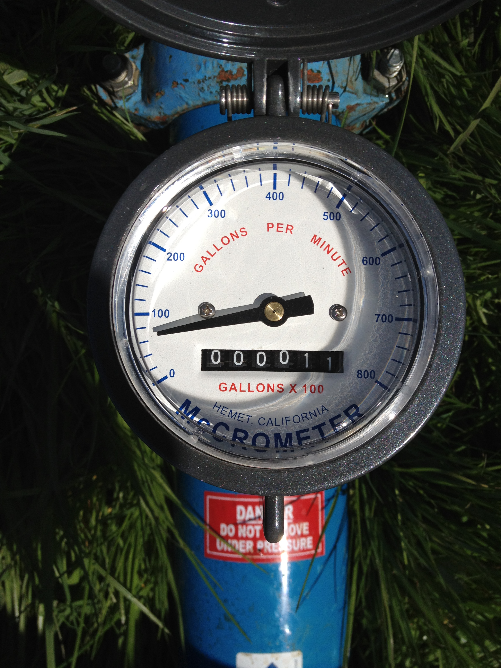
Funding for drought-related and/or contamination issues
State Water Board has opened a County-wide and Regional Funding Solicitation
Counties or eligible partner entities such as non-profits and RCDs
Implement regional programs that address drought-related and/or contamination issues
State small water systems and domestic wells serving disadvantaged communities (DACs) and low-income households.
https://www.waterboards.ca.gov/safer/funding_solicitation.html

Slide 4
Contact Information
Groundwater Specialist
Chris Watt
chris.watt@waterboards.ca.gov
Flow and Riparian Specialist
Bryan McFadin
bryan.mcfadin@waterboards.ca.gov

