Slide 1
State Water Board Updates Sonoma County Drought Town Hall
Philip Dutton
Division of Water Rights
August 4, 2022
Notes:
Role of the Division; water rights priority in regards to diversions of surface water from the RR stream system.

Slide 2
Curtailment and Correlative Sharing in the Russian River Watershed
Appropriative Water Rights
Have a discrete priority date and are curtailed based on the priority of the right.
Once curtailed, right holders must fully cease water diversions.
Riparian Water Rights
Do not have unique priorities. When a reduction is required, rights share the common water available to them through correlative reductions from their reported demand (2017-2019).
Right holders are authorized to divert up to their assigned water budget for the month.
Exceptions to Curtailment
Certifications and approved petitions authorized under the 2021 Regulation continue to be valid for 2022, unless modifications are requested.

Slide 3
2022 Emergency Regulation Implementation
3
June 1 – Regulation approved by the Office of Administrative Law
June 14 – State Water Board issued “Orders Regarding Curtailment Status” to each right holder in the Russian River Watershed
June 16 – Posted the first Curtailment Status List (CSL) under the 2022 Regulation, however no rights were curtailed
Lake Mendocino, October 2021. DWR.
Notes:
The State Water Board's new emergency regulation was approved and took effect on June 1. On the 14th, the Division issued these orders. Who received an order? Right holders – include the big entities like Sonoma Water, RR FCD in Mendo County, but also include the small communities, businesses, and individuals that rely on water from the RR and the tribs for drinking, irrigation, fire protection, and other beneficial uses.

Slide 4
2022 Emergency Regulation Implementation
4
June 30 – CSL Updated for July
Curtailed 88 appropriative water rights
Reduced 245 riparian water rights
Most water rights impacted were in the URR
July 28 – CSL Updated for August
Curtailed 260 appropriative water rights
Reduced 325 riparian water rights
Lake Mendocino, October 2021. DWR.

Slide 5
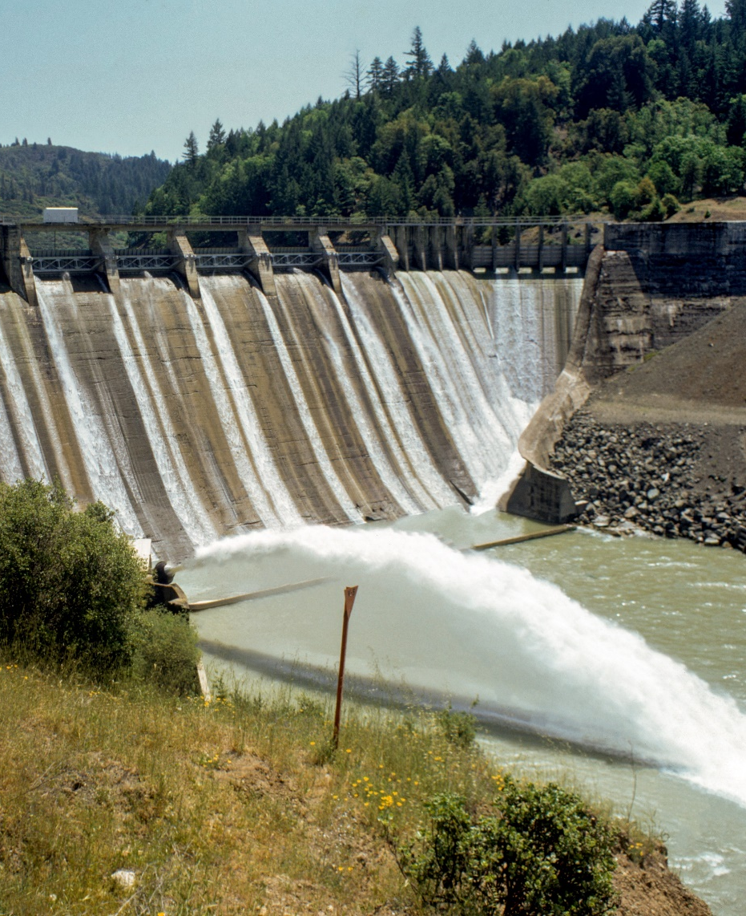
Additional Curtailments Expected
Federal Energy Regulatory Commission (FERC) Flow Variance
FERC approved a variance that will reduce flows from the PG&E Potter Valley Project to the Russian River Watershed
PG&E will now release 5cfs to the East Branch Russian River
Staff expect to post a revised Curtailment Status List with further curtailments this week
Scott Dam at Lake Pillsbury. DWR.

Slide 6
Lake Mendocino 10,000 AF Reservation
10,000 acre-feet of stored water is available for use by certain junior appropriators within Sonoma County
Eligible water users may submit a claim online identifying their rediversion via the Water Right Form and Survey Submittal Portal (Lake Mendocino Reservation Use Form)
Right holders may request access to the claim form for submission within 14 calendar days of an initial curtailment status
Email RussianRiverDrought@waterboards.ca.gov
Include the water right identification number and the right’s basis for the rediversion

Slide 7
State Water Board Information Resources
Russian River Drought Website
https://www.waterboards.ca.gov/drought/russian_river/
Subscribe to the Russian River Drought Email List or Contact Us
https://www.waterboards.ca.gov/drought/russian_river/#stay_informed
Check your Curtailment Status
https://www.waterboards.ca.gov/drought/russian_river/#tableau

