Slide 1
Windsor Water District NEW Recycled Water Fill Station
Veronica Siwy
Deputy Director of Water & Environmental Management
Town of Windsor

Slide 2
Notes:
I’m proud to say that Windsor has always been a leader among communities nationwide in the use of recycled water for the irrigation. It was one of the first in the nation to plumb an entire residential neighborhood with recycled water for landscape irrigation and also provide recycled water for toilet flushing, which it still does at Windsor High School and one of the fire stations in Town.
Windsor treats its water to an advanced standard, which allows for unrestricted reuse in virtually all reclaimed water applications.

Slide 3
Recycled Water FAQs
What is recycled water and where does it come from?
Is recycled water safe?
Why should we use recycled water?
How much recycled water does Windsor produce?
Notes:
What is recycled water and where does it come from?
Recycled water is wastewater generated from homes and businesses. When Windsor residents take a shower, wash dishes, use the bathroom or do laundry, their wastewater is sent through the sewer system to the wastewater treatment plant where it carefully processed to be safe for a variety of beneficial reuse
Is recycled water safe?
Yes! Recycled water is regulated by the California State Water Resources Control Board. Windsor’s staff are responsible for demonstrating that it meets these standards and is safe for reuse.
Why should we use recycled water?
Every drop of recycled water that is used is a drop of potable water that is conserved. Even before the drought, recycled water was an important way to conserve our valuable drinking water resources. And now that we are in a drought, recycled water use has become even more important.
How much recycled water does Windsor produce?
In 2021 Windsor processed about 560 MG of wastewater, and 280 MG of that was directed toward recycled water applications.

Slide 4
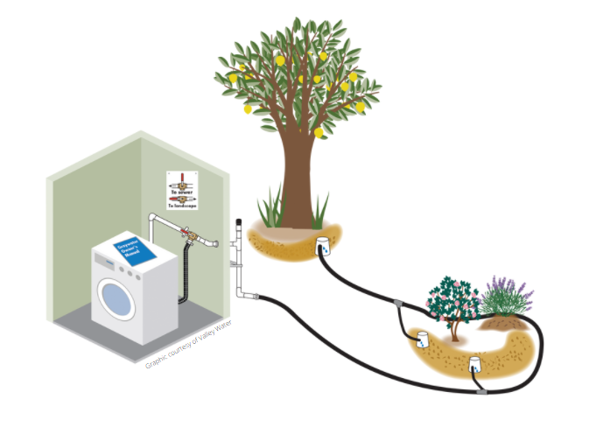
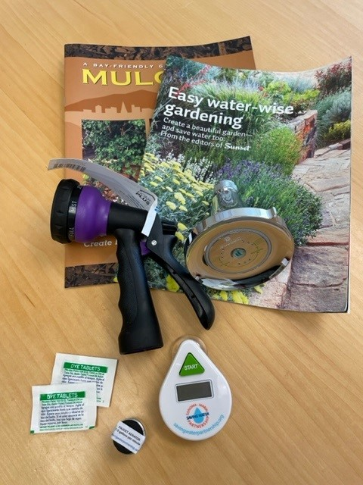
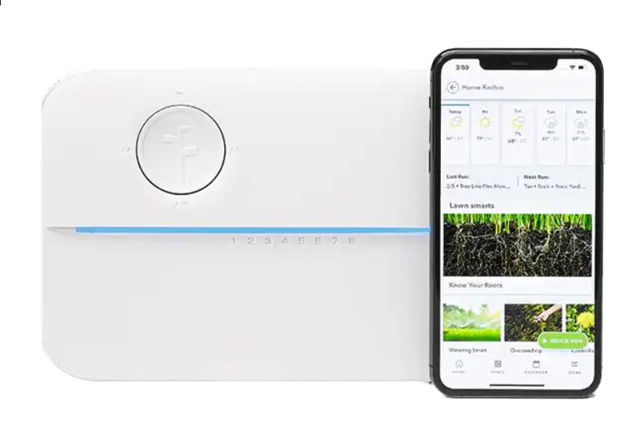
Windsor and Drought
Notes:
Windsor is currently in a Level 2 Water Shortage Condition, which requires us to meet a 20% reduction in Russian River diversions compared to 2020.
Windsor residents are doing a great job conserving and in June of this year we used almost 21% less water than in June of 2020.
The Town has several programs in place to help with conservation: Turf rebate program, efficient irrigation rebate program, Rachio Smart Irrigation Controller rebate program, laundry to landscape rebate program, water conservation kit giveaways and an active public outreach program.
But given the extended drought conditions we were looking for ways to do more.

Slide 5
Windsor’s new Recycled Water Fill Station
Notes:
The Town of Windsor has expended its recycled water program to offer free recycled water through a small volume fill station available to citizens, commercial businesses and industries for irrigation of ornamental landscapes and residential gardens. Recycled water is available to self haulers at the Town staffed fill station in Keiser Park

Slide 6
How do I access recycled water?
Easy as 1, 2, 3!
Step 1: Complete a recycled water fill station application
Step 2: Review the Site Supervisor Training
Step 3: Complete a recycled water fill station self-certification form
www.townofwindsor.com/recycledwater
Notes:
Entire process takes about 15 minutes. Hard copy applications are available at Public Works. Will need to complete the process each year. Please do not show up at the fill station site without having completed the paperwork!
Site Supervisor Training gives guidance on do’s and don'ts for recycled water use

Slide 7
Recycled Water Fill Station FAQs
Where is it?
Keiser Park, 700 Windsor River Road in Windsor. Near Ballpark “C”
What days and hours does it operate?
Tuesday – Thursday, 9 a.m. – 2 p.m.
Hours of operation are subject to change. Check the Town’s website for most current information!
How much recycled water can I get?
Up to 300 gallons per trip
Program for large volume applications (ex: dust control)
When will the program end?
When demand drops off or when the wet season starts
Notes:
Map of the fill station location is available on the Town’s website

Slide 8
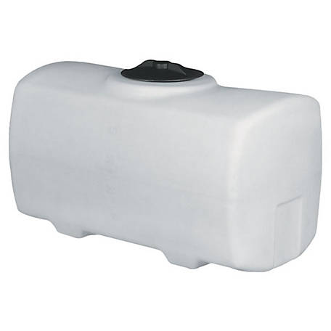
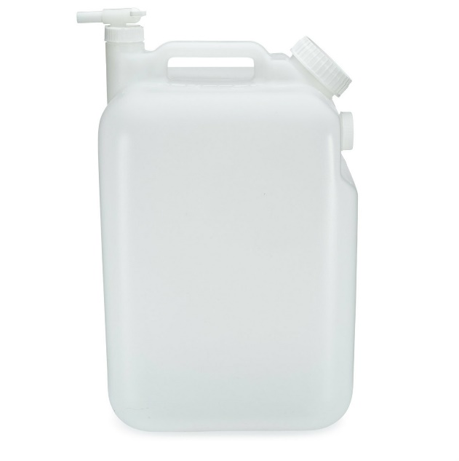
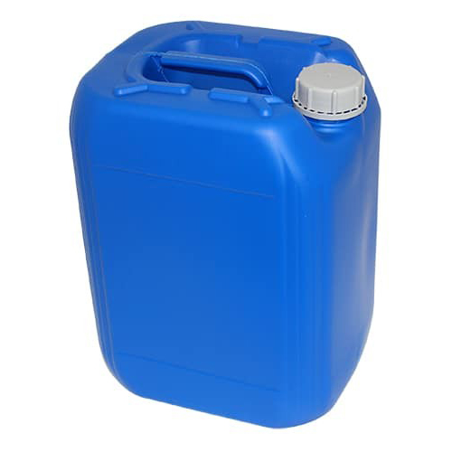
Examples of Acceptable Hauling Containers
Notes:
The Town accepts a variety of sizes and types for hauling containers. The main requirement is that the container must be sealable, and your vehicle should be suitable for hauling the size container you are using. For example, the tote on the upper corner of the slide is about 300 gallons. You wouldn’t be able to haul a tote that size strapped to the top of your sedan!

Slide 9
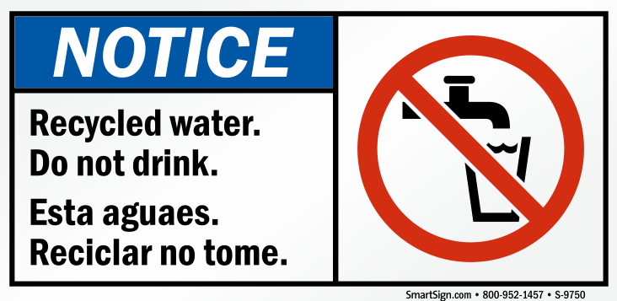
Example of Acceptable Container Label
Notes:
All containers used to store or transport recycled water must be clearly labelled with the message “Recycled Water: Do not drink”

Slide 10
Recycled Water is NOT Suitable For:
Drinking
Cooking or use in the kitchen
Bathing or showering
Filling swimming pools or spas
Children’s water toys
Connection to the household domestic plumbing system
Connection to piped or below ground irrigation systems
Discharging to the street gutter, storm drain or creek

Slide 11
Watering Guidelines
- Use hand-watering methods (hose, buckets, watering cans, etc.) or above ground, hose connections to drip systems or sprinklers
- Watering is not allowed before, during or immediately following rain events
- Watering is not allowed when the soil is already very wet
- Make sure recycled water soaks into the soil and does not pond
- Make sure recycled water is not leaving the yard in runoff or overspray
- Recycled water must not enter street gutters, storm drains or creeks
- Recycled water has a higher nitrogen content than potable water, so fertilizer should be minimized or avoided

Slide 12
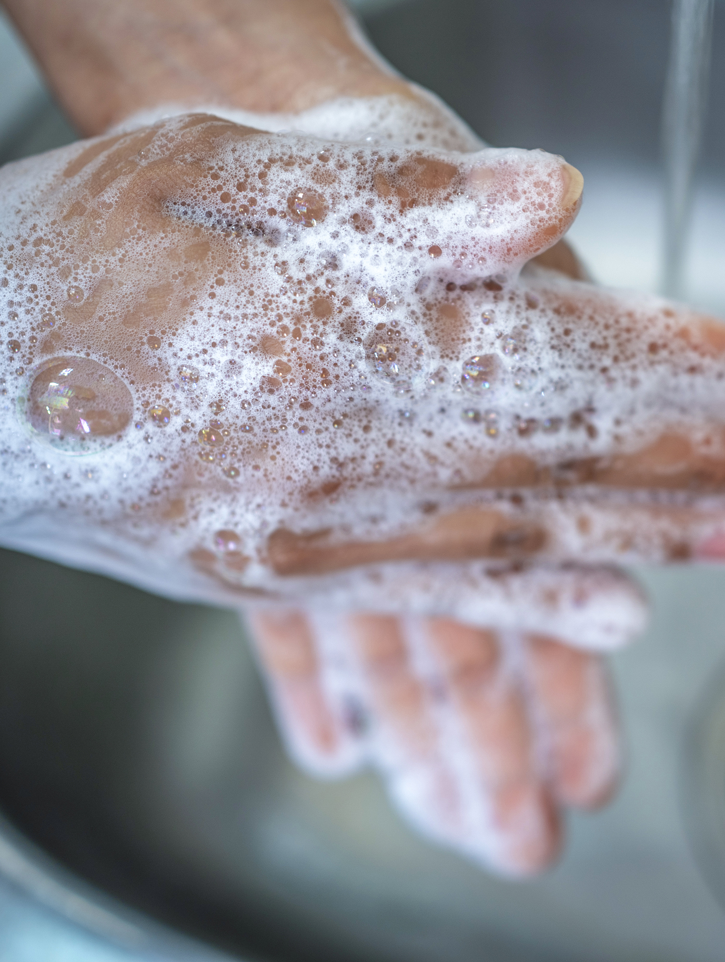
Health & Safety Guidelines
Do not drink recycled water or use it for food preparation
Apply hand sanitizer or wash hands with soap and domestic drinking water after working with recycled water, especially before eating or smoking
Recycled water can be used to water fruits and vegetables, however, remember to wash fruits and vegetables with potable water prior to eating or cooking
All equipment (hoses, etc.) and storage containers that come into contact with recycled water shall be dedicated for use only with recycled water
Prevent spraying of recycled water onto drinking water fixtures or food handling areas

Slide 13
Veronica Siwy, Deputy Director of Water & Environmental Management vsiwy@townofwindsor.com or 707-838-1218 www.townofwindsor.com/recycledwater

