Slide 1
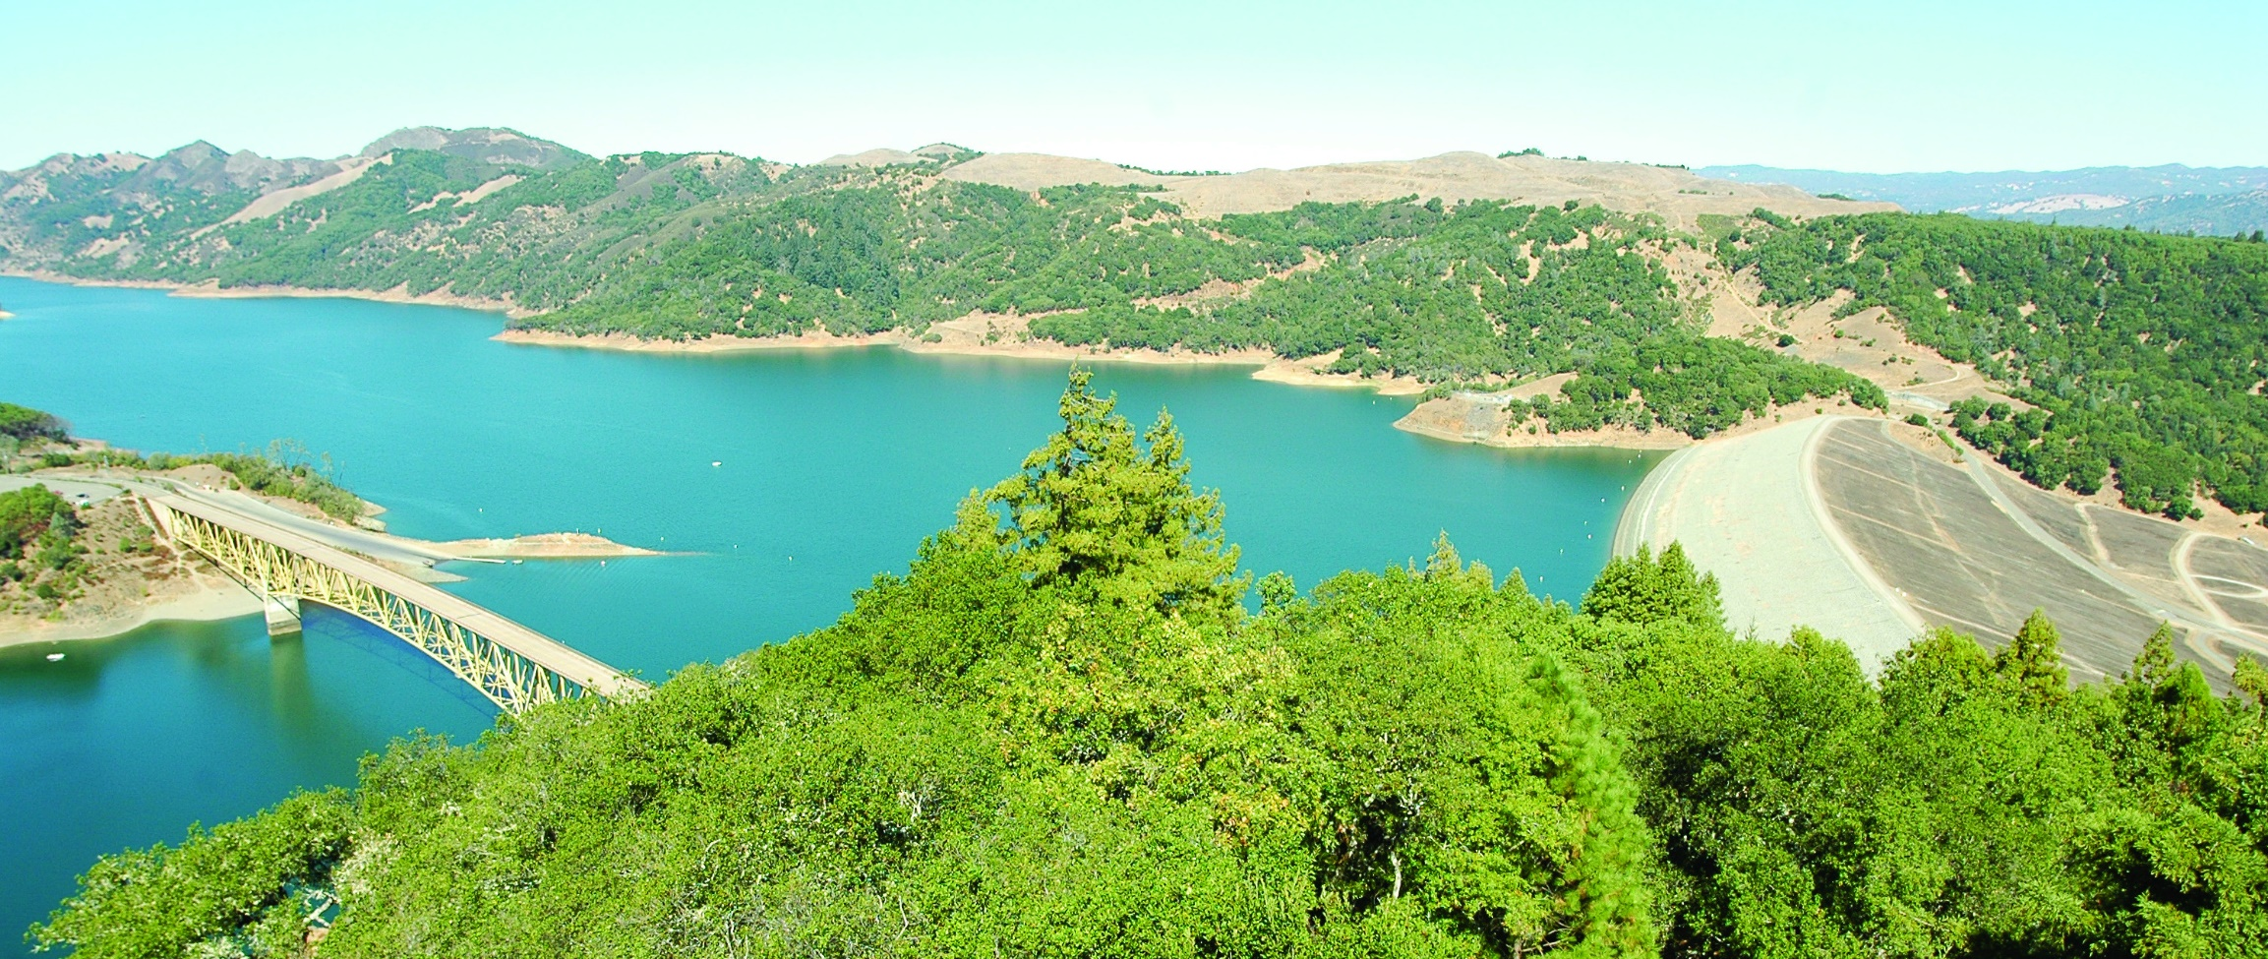
Sonoma County Drought Outlook
October 2022
Photo: USACE
Presented by: Brian Garcia - Warning Coordination Meteorologist NWS Bay Area

Slide 2
Topics
Fire Season: Current and Forecast
Winter Outlook: ENSO and Forecast

Slide 3
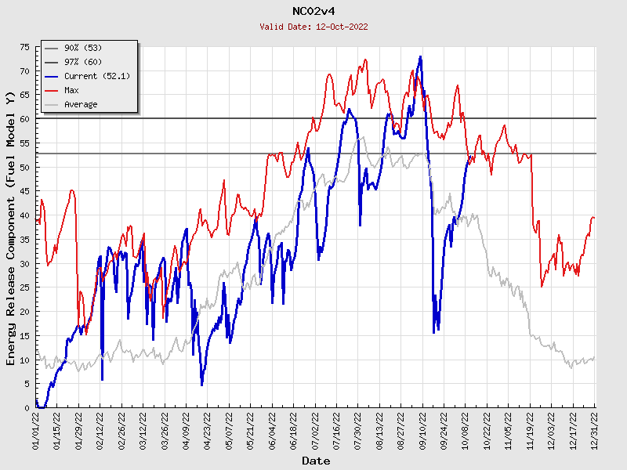
ERC’s for North Bay

Slide 4
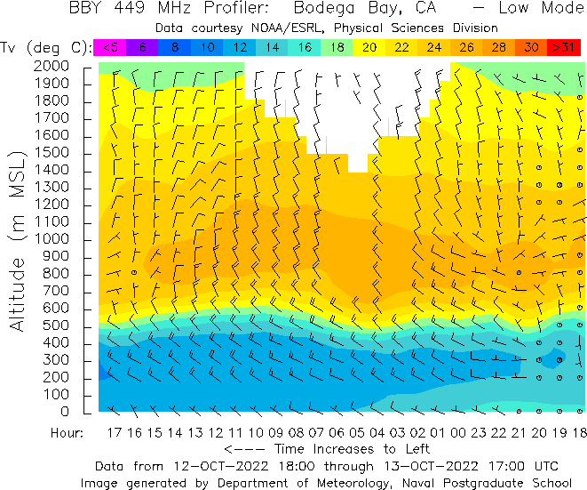
Marine Layer

Slide 5
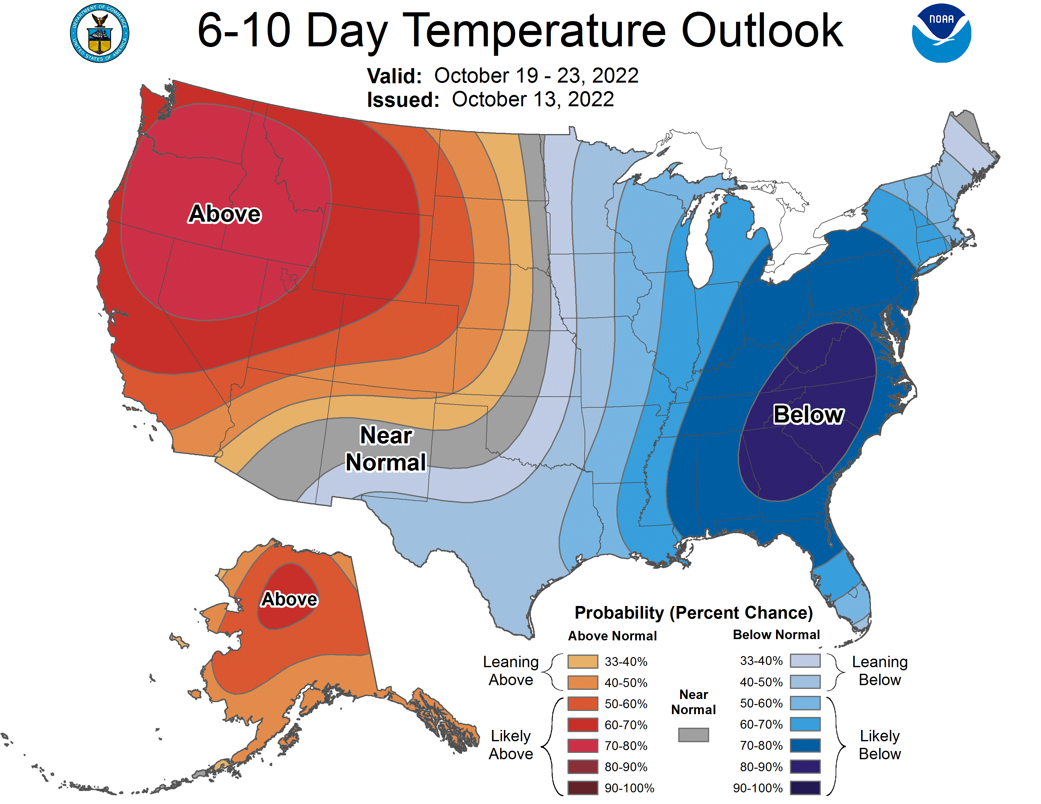
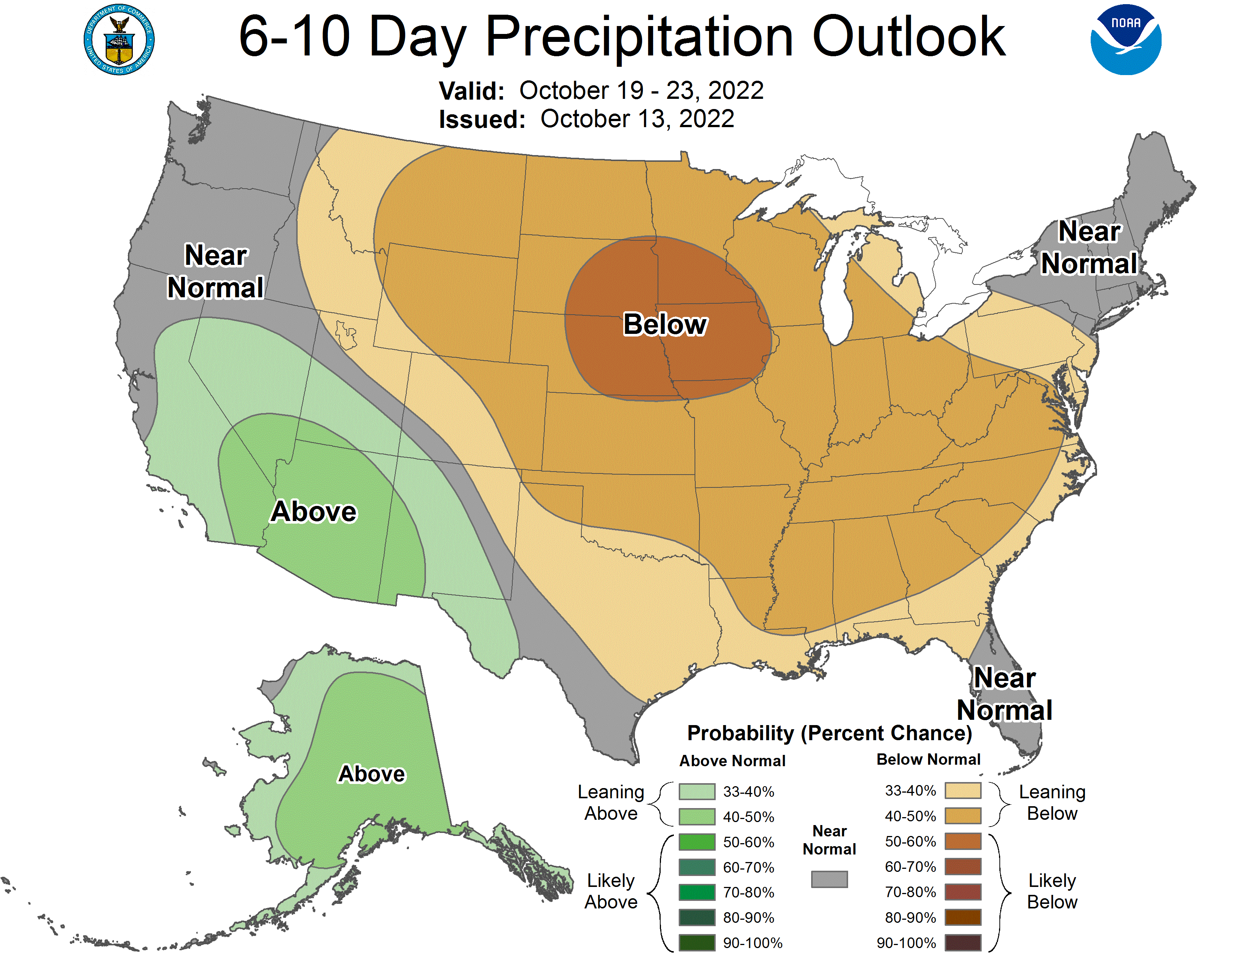
6-10 Outlook

Slide 6
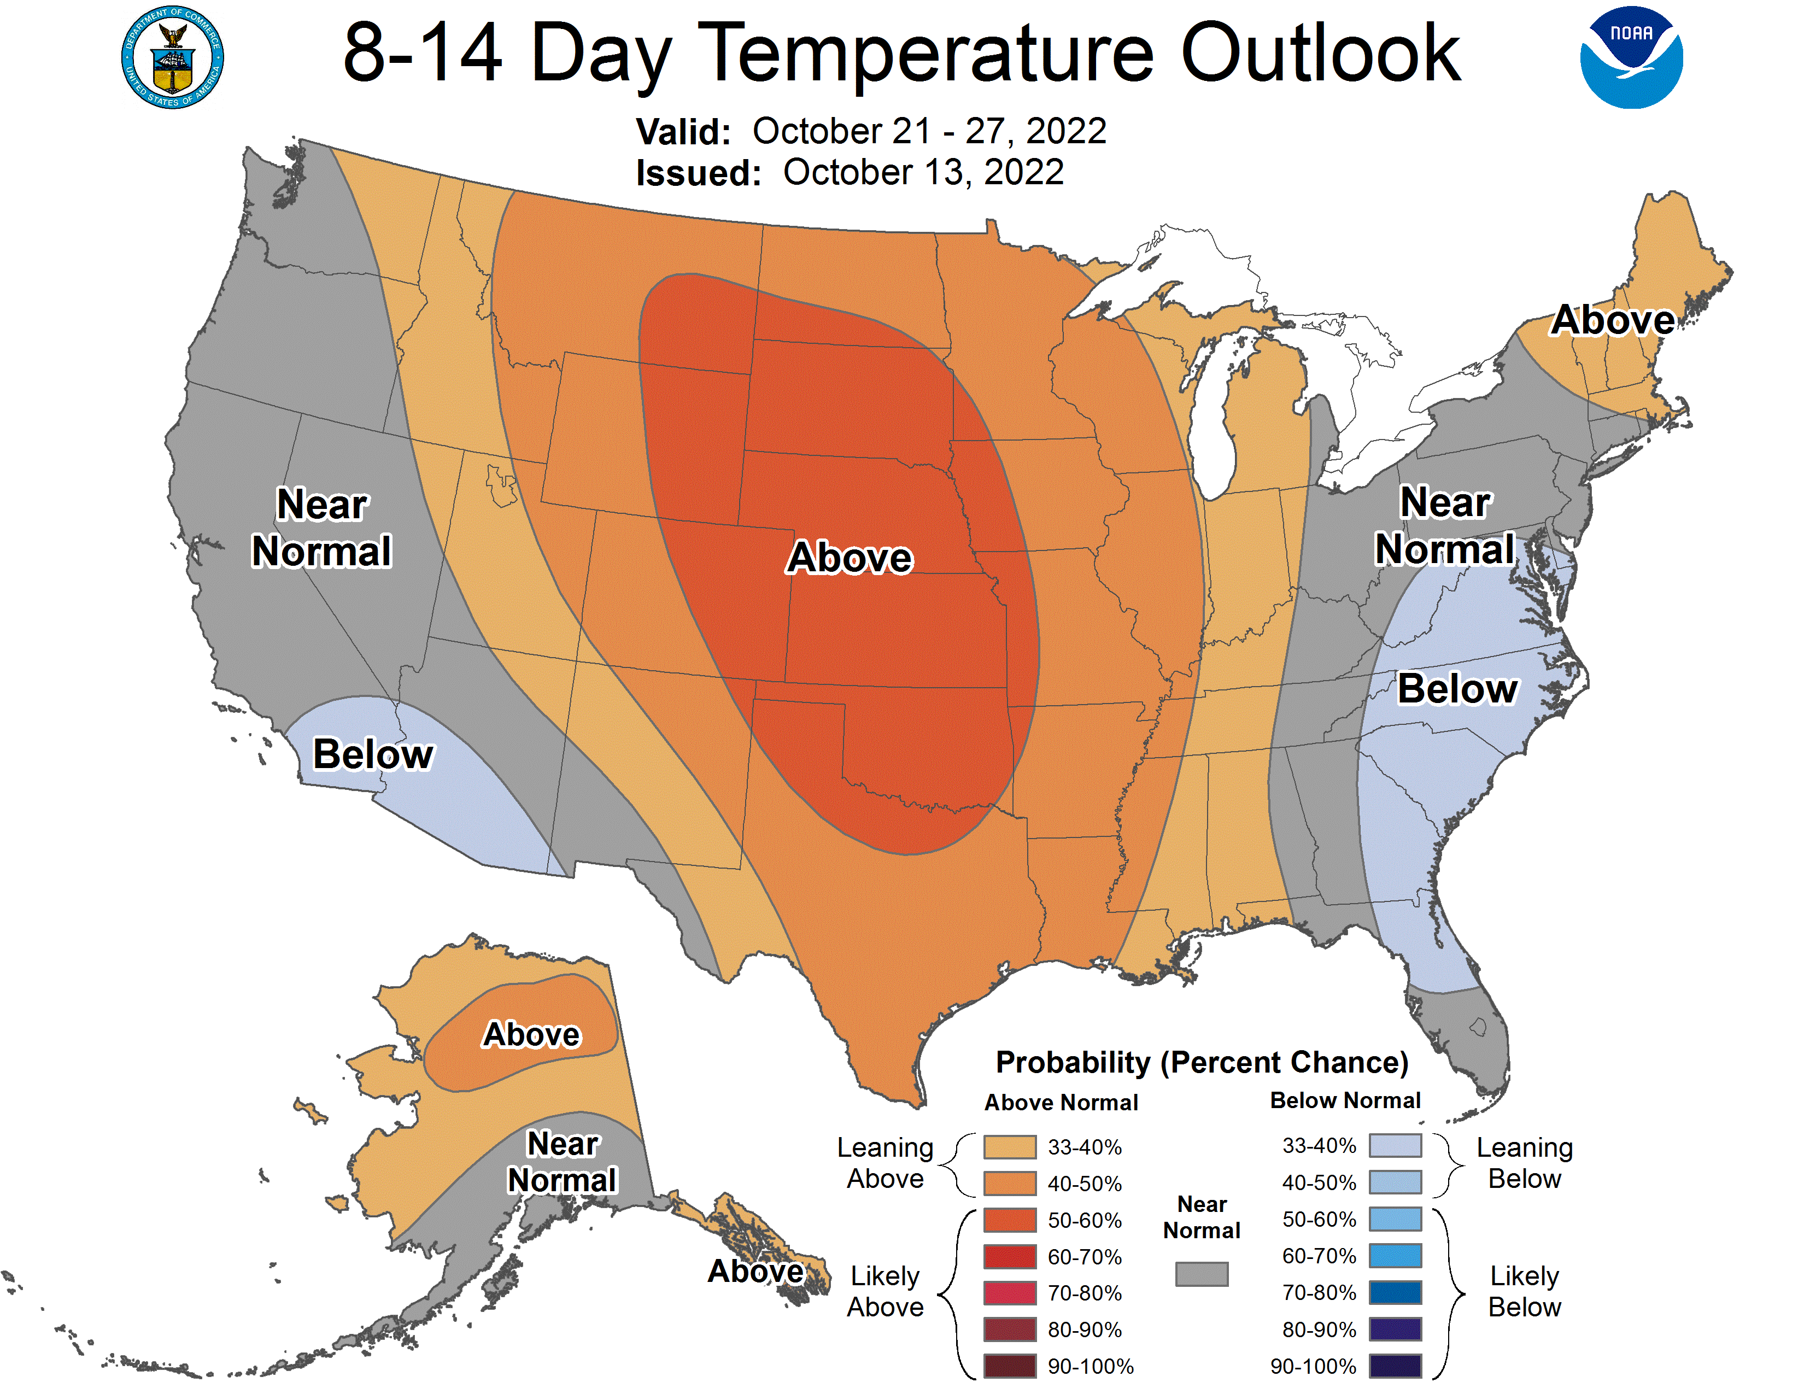
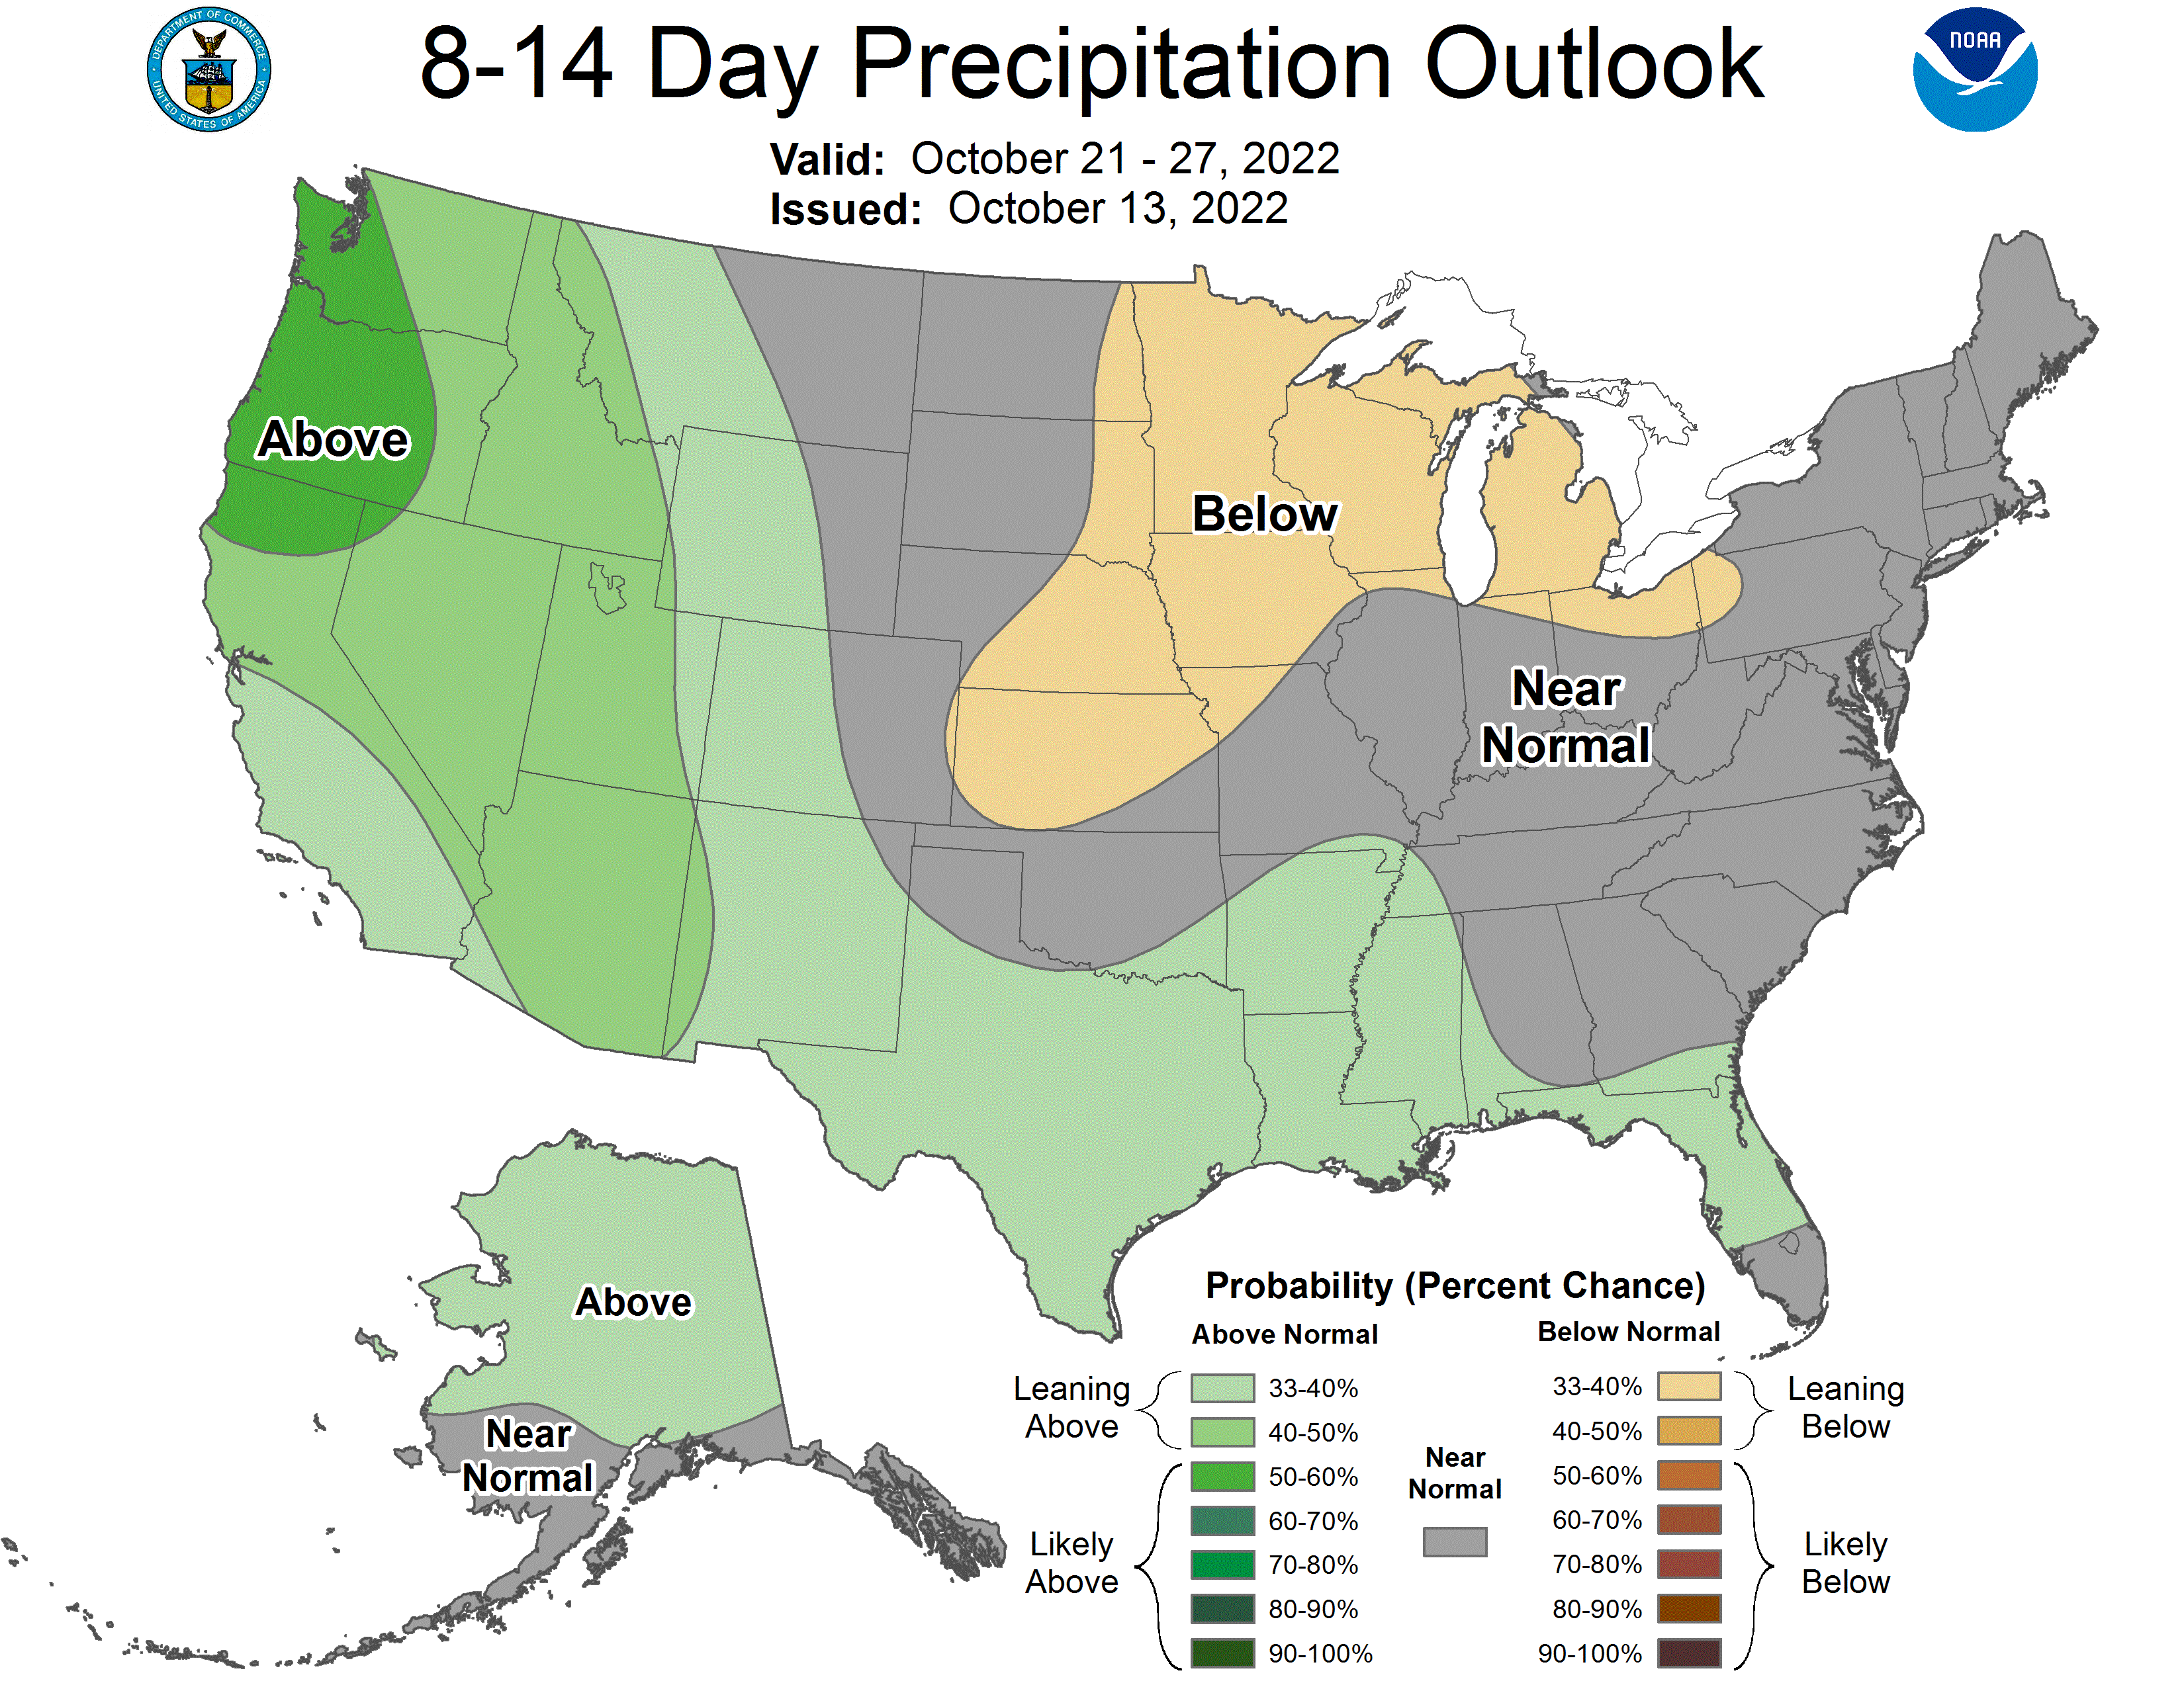
8-14 Outlook

Slide 7
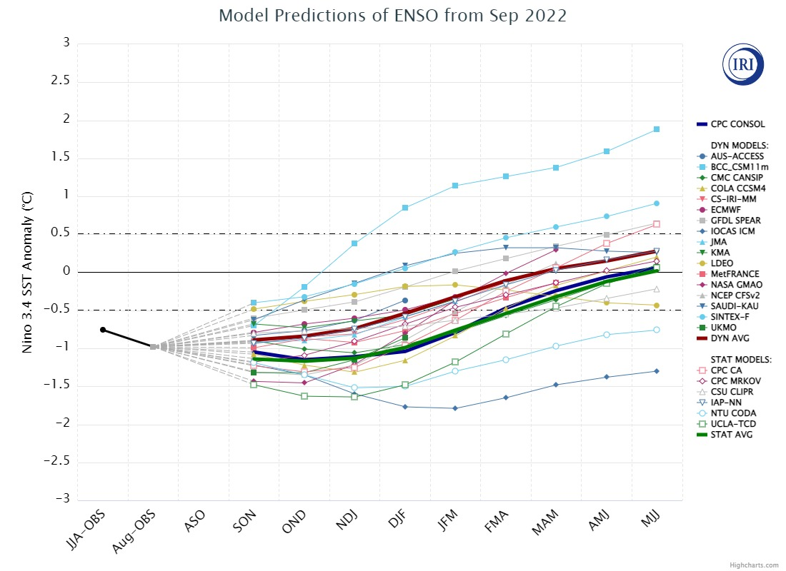
El Niño
“La Nada”
La Niña

Slide 8
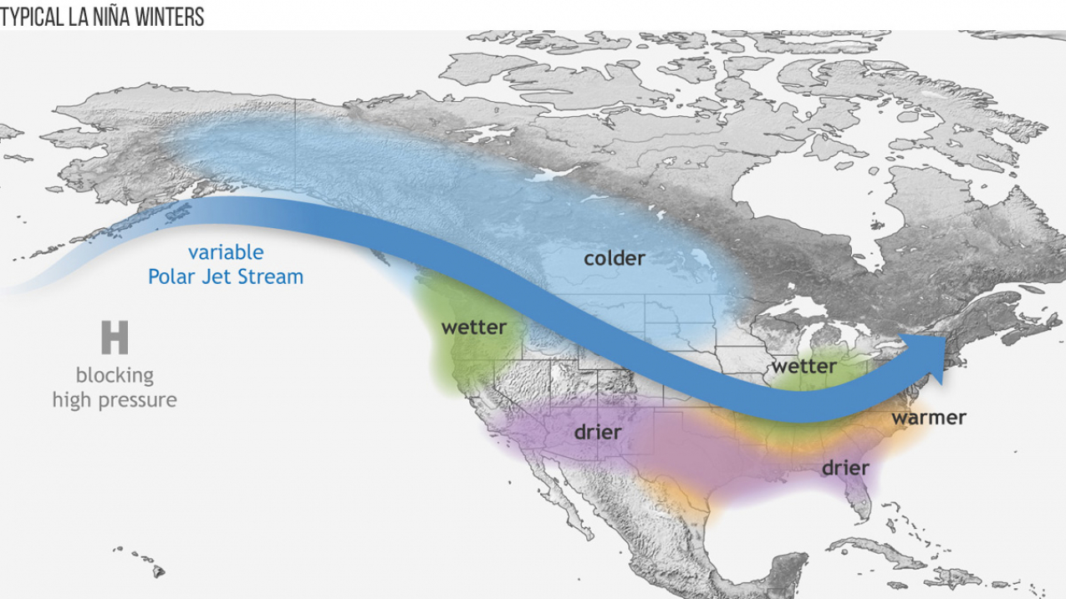
La nina winters

Slide 9
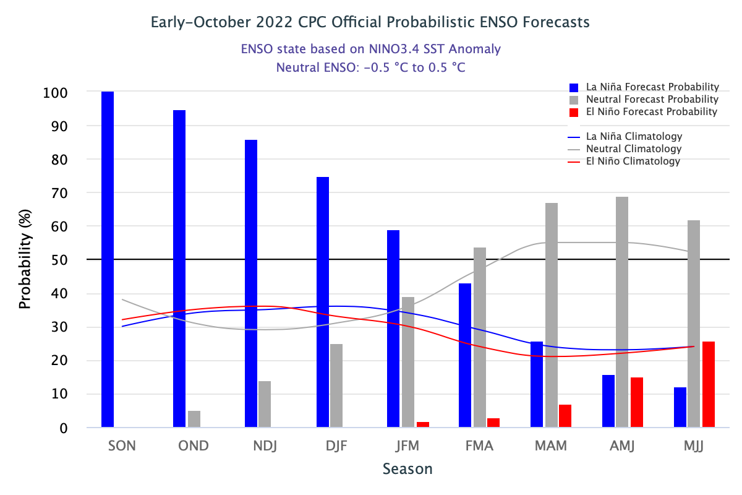
Forecasts

Slide 10
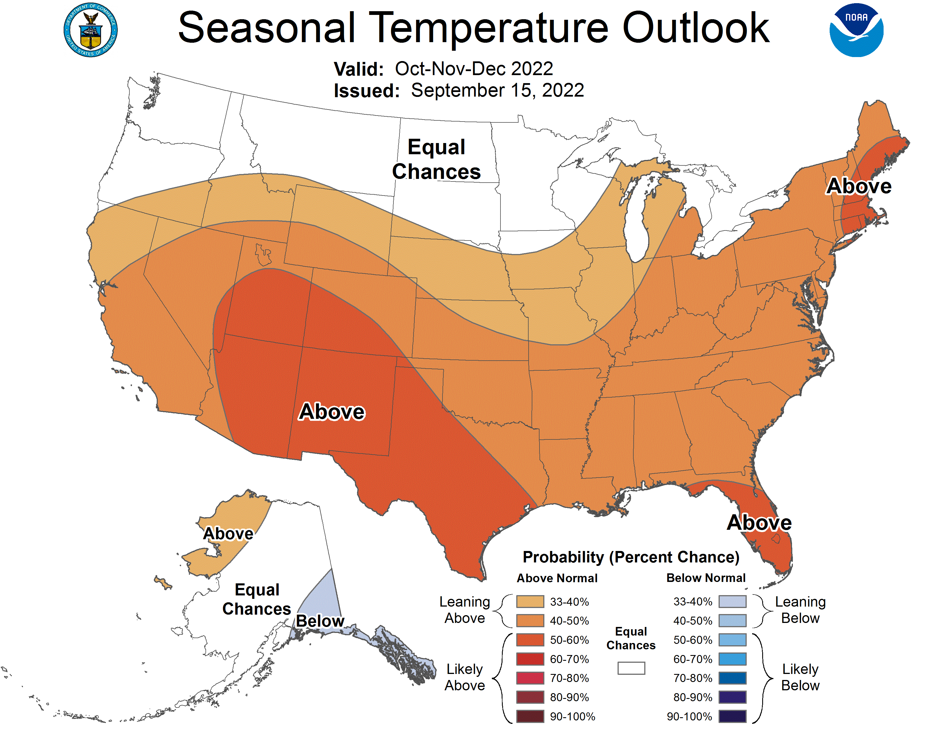

Slide 11
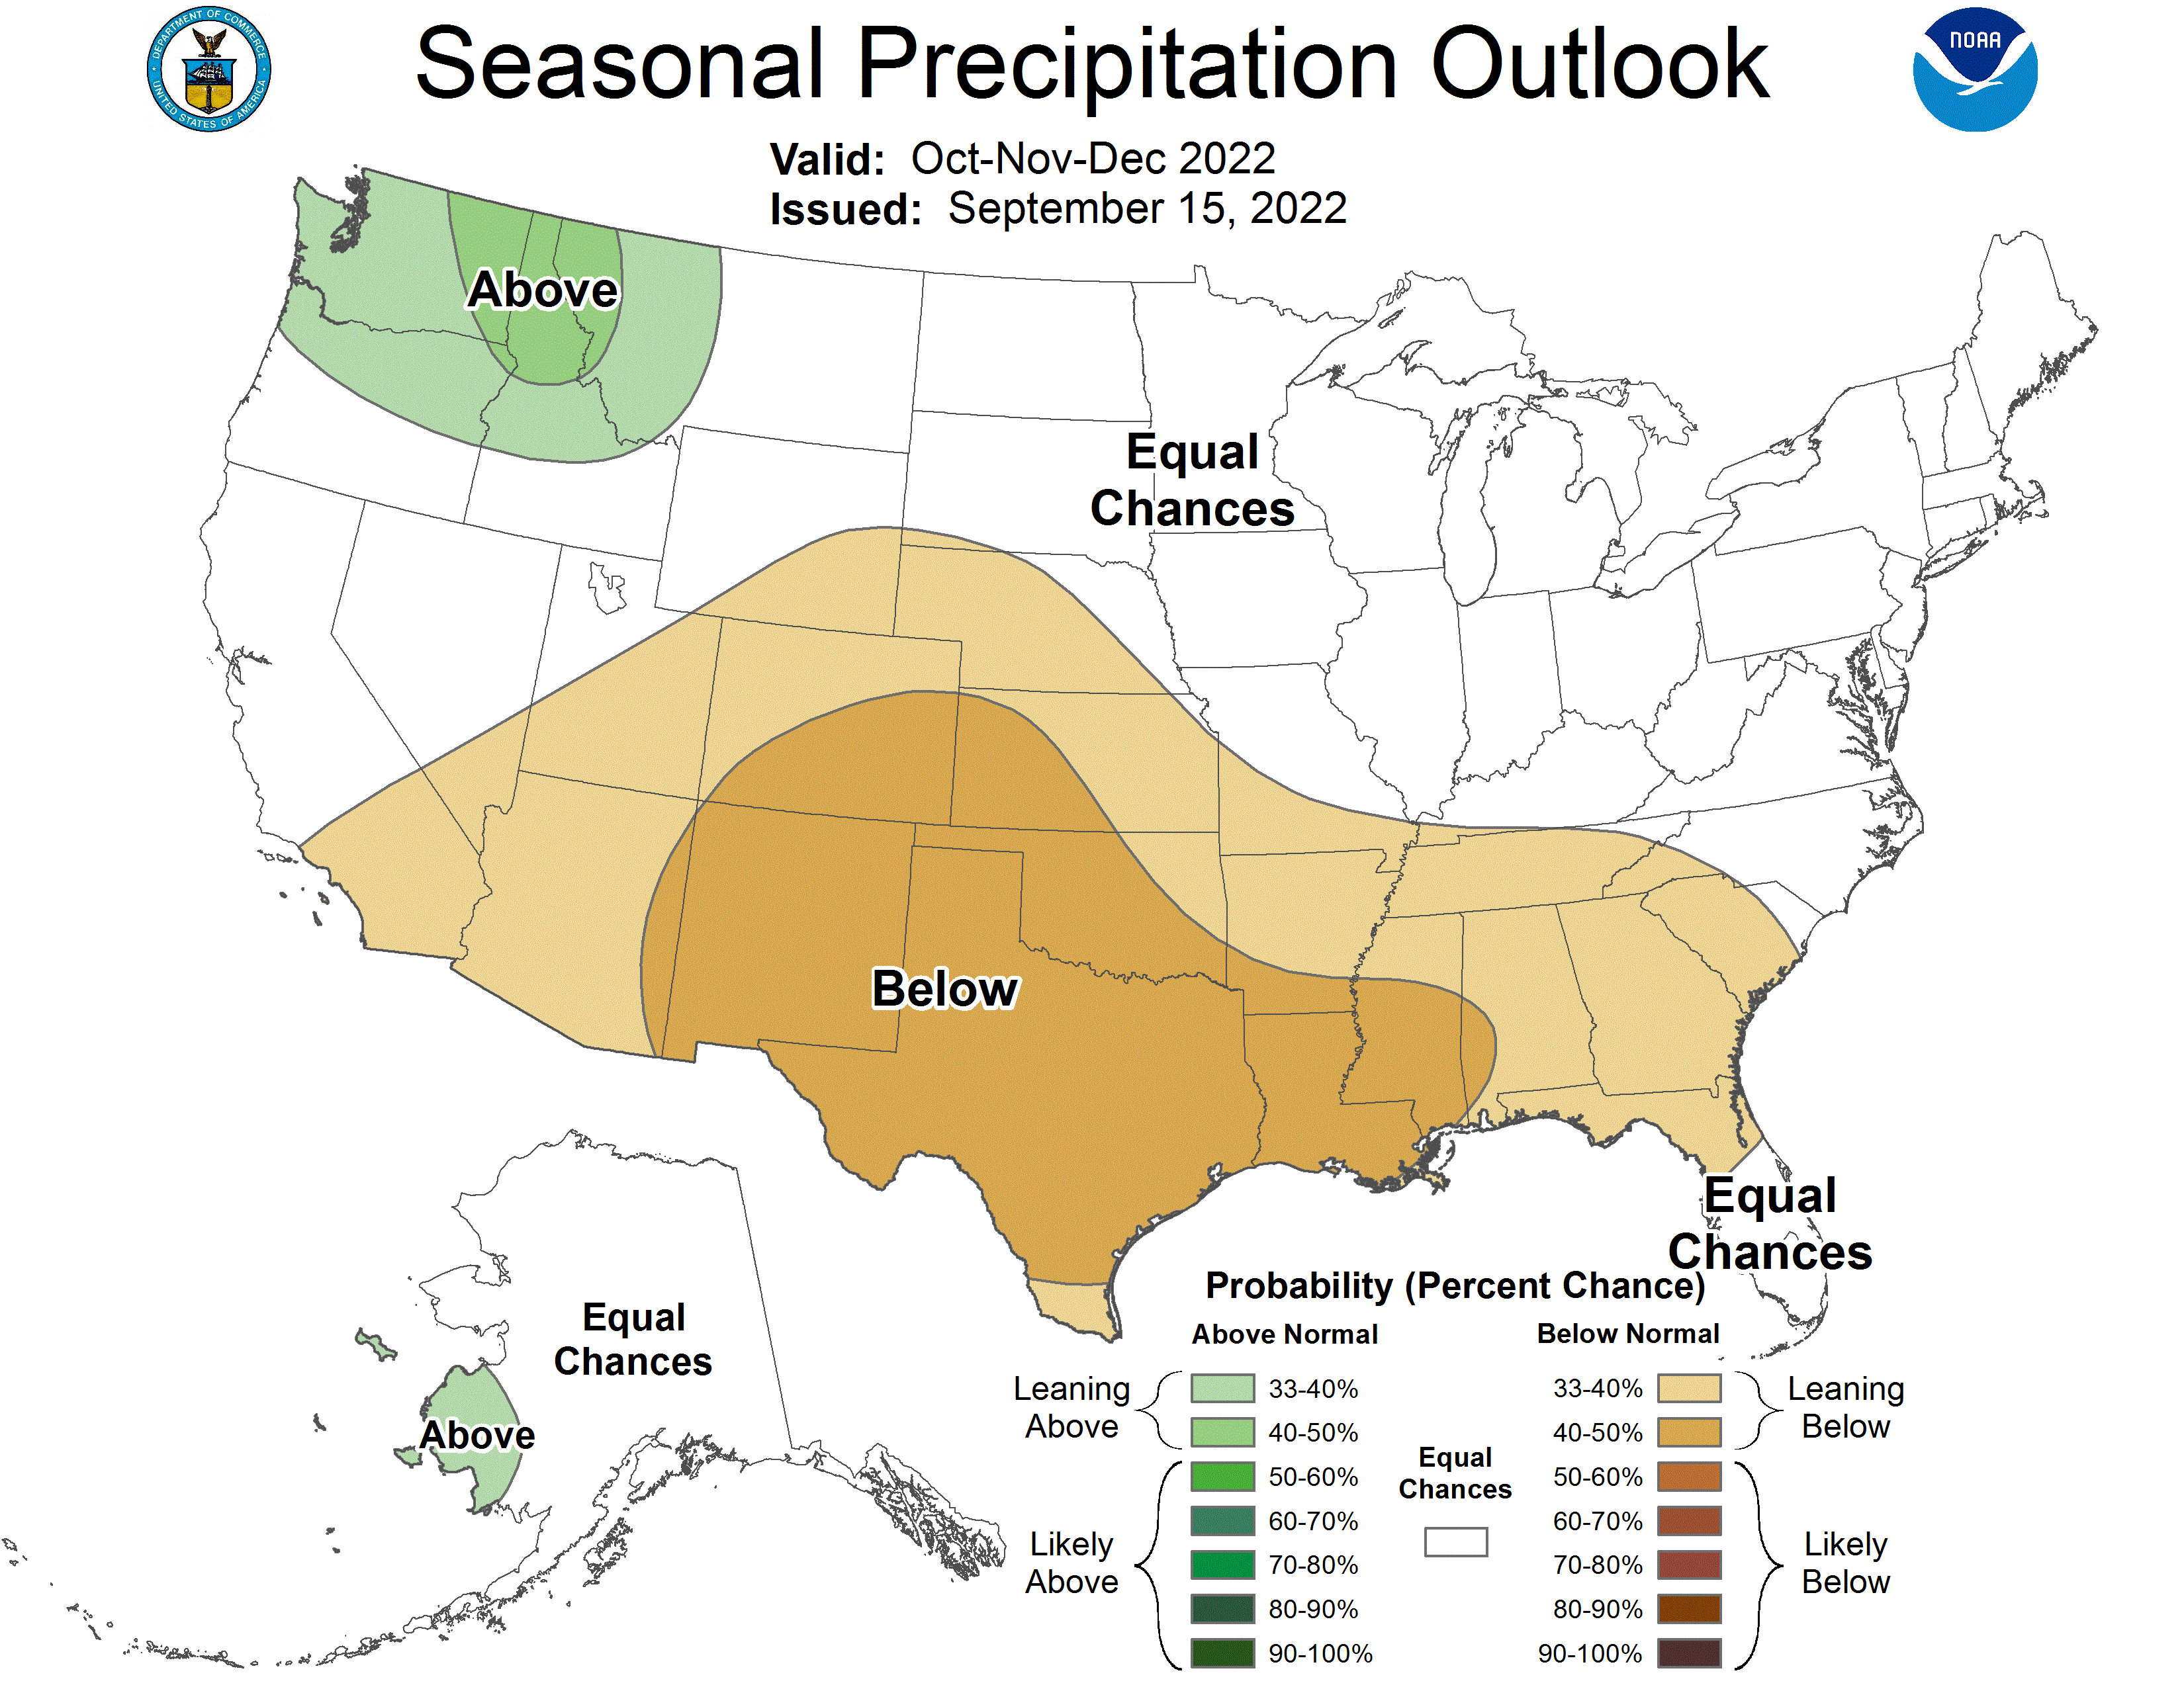

Slide 12
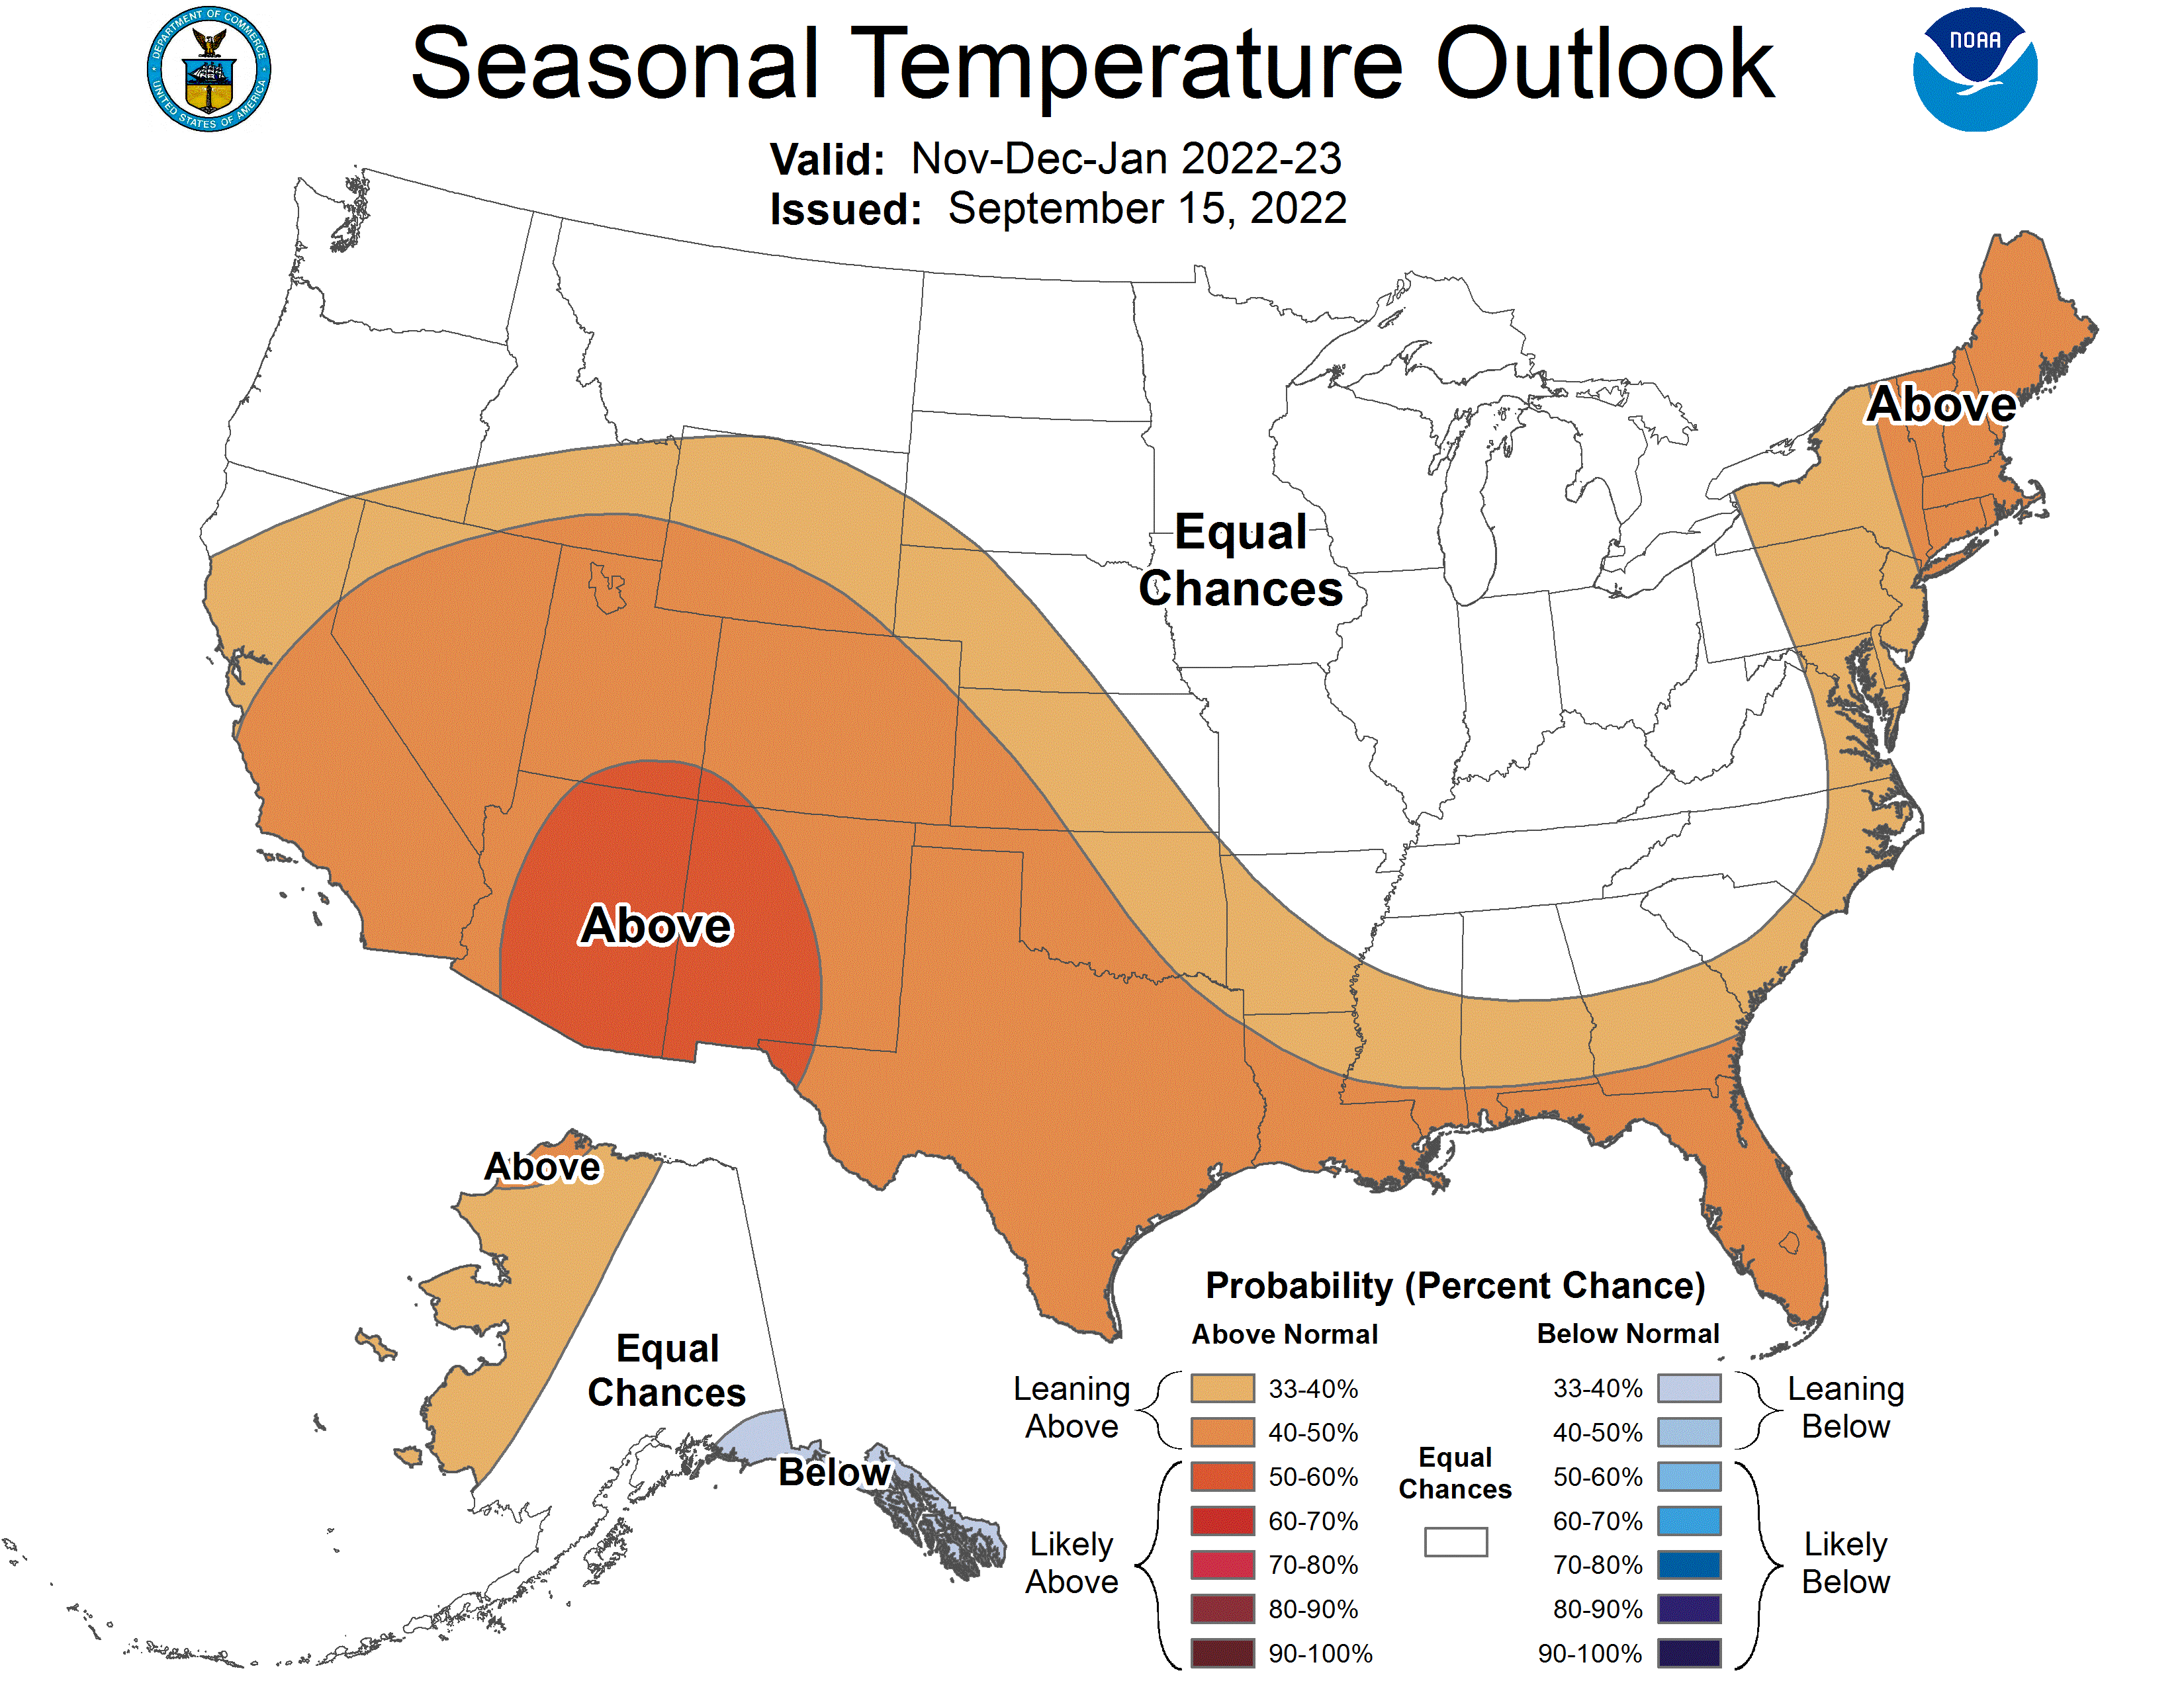

Slide 13
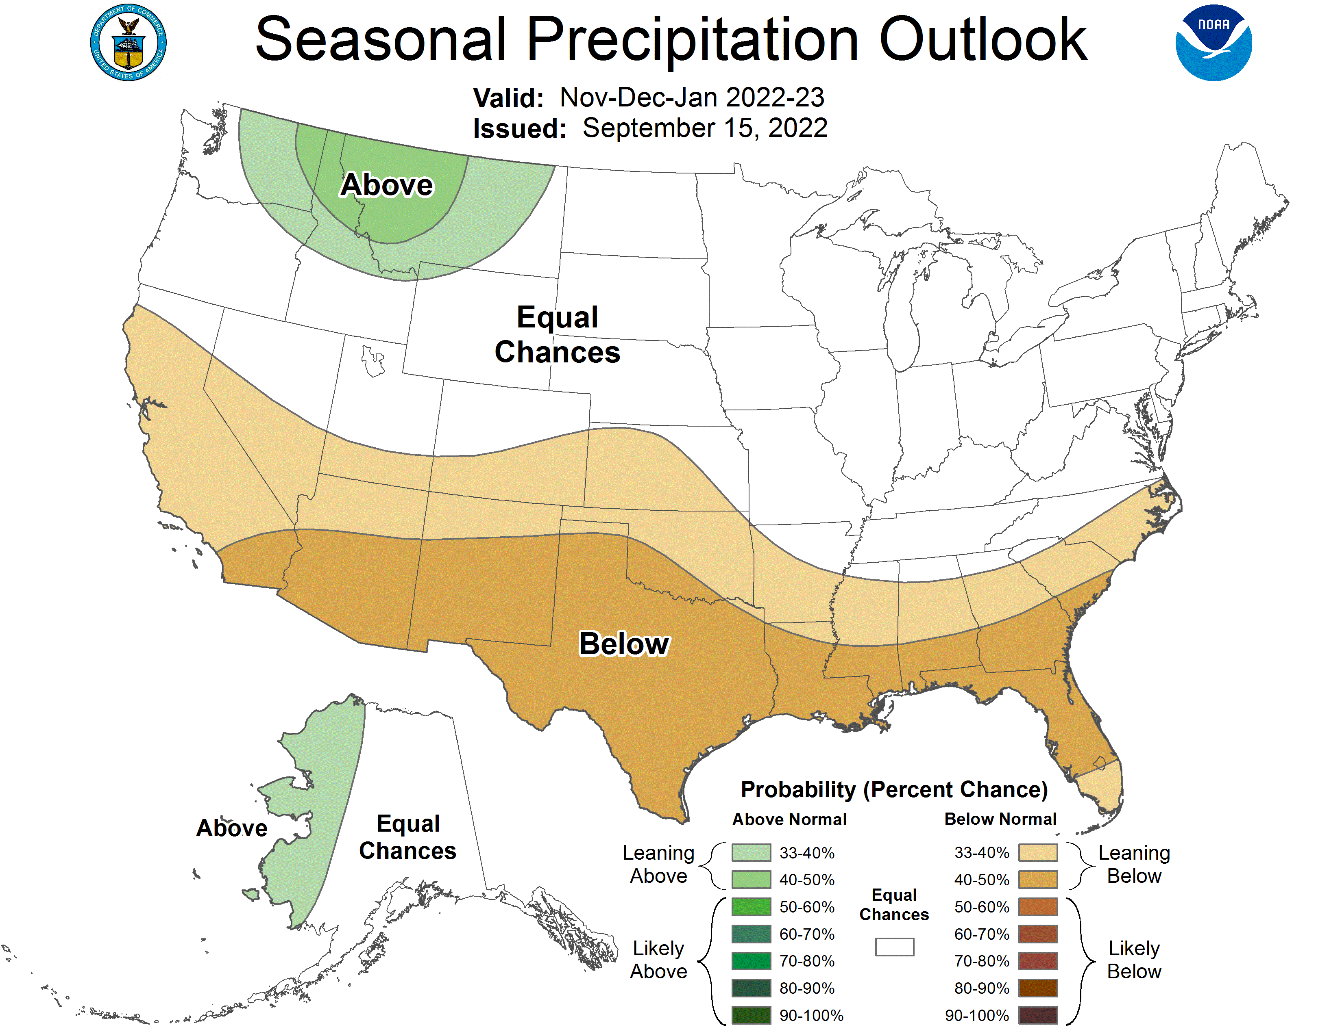

Slide 14
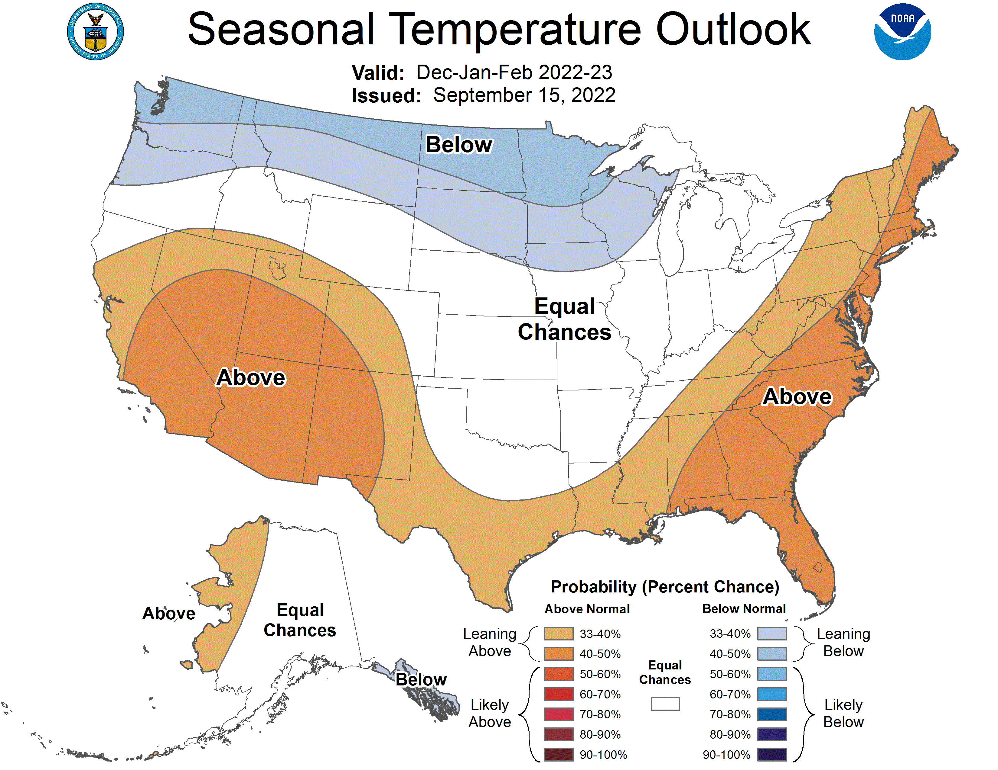

Slide 15
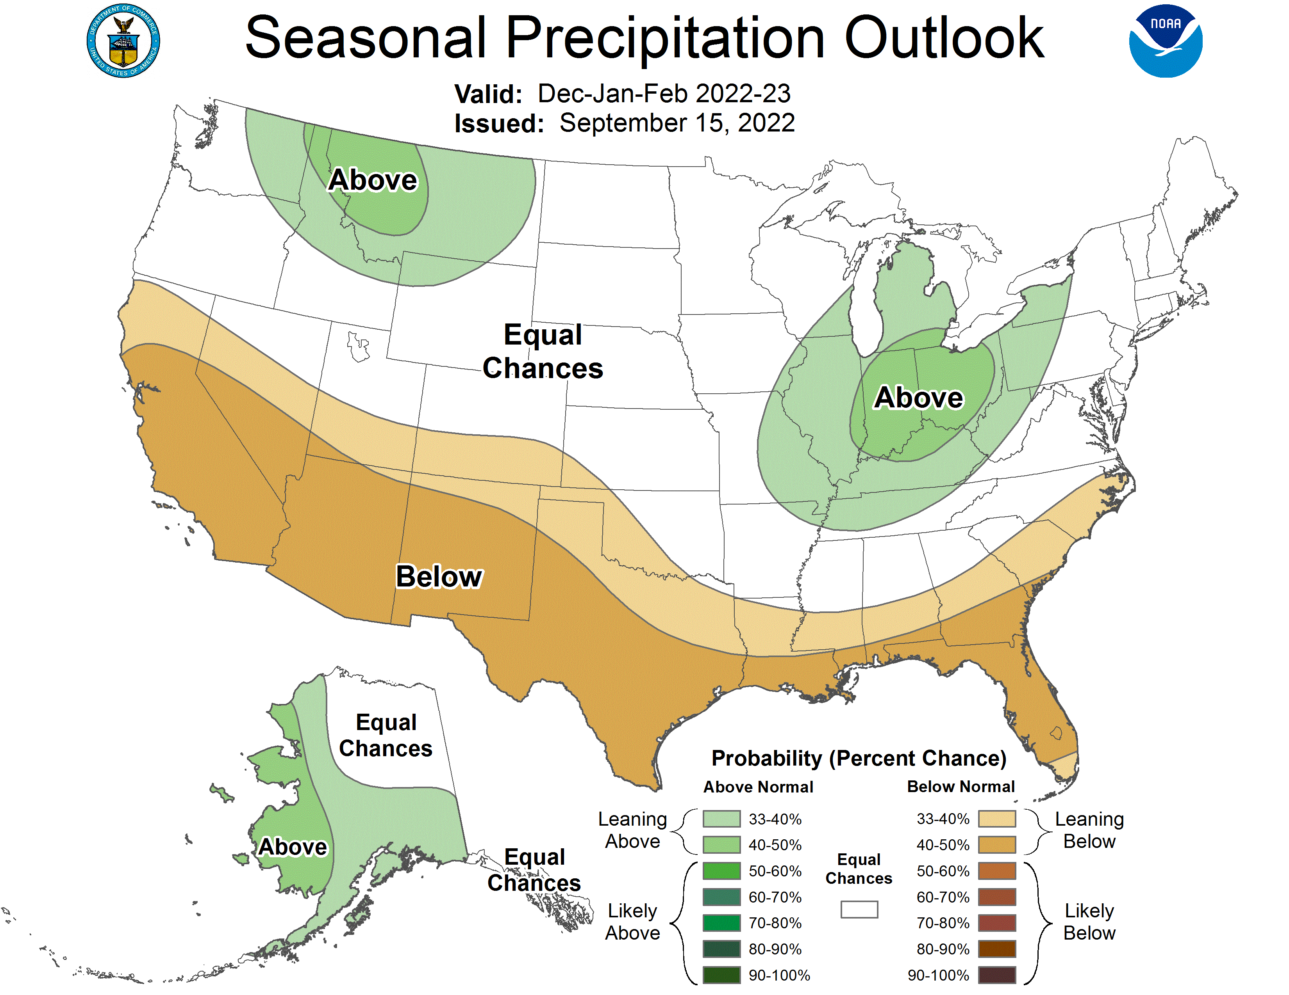

Slide 16
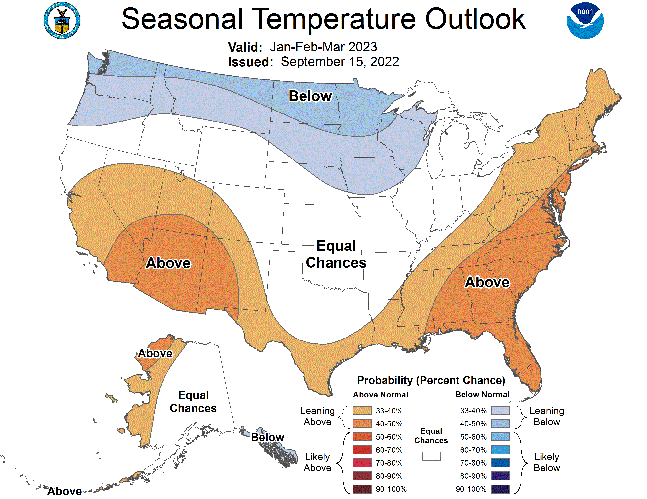

Slide 17
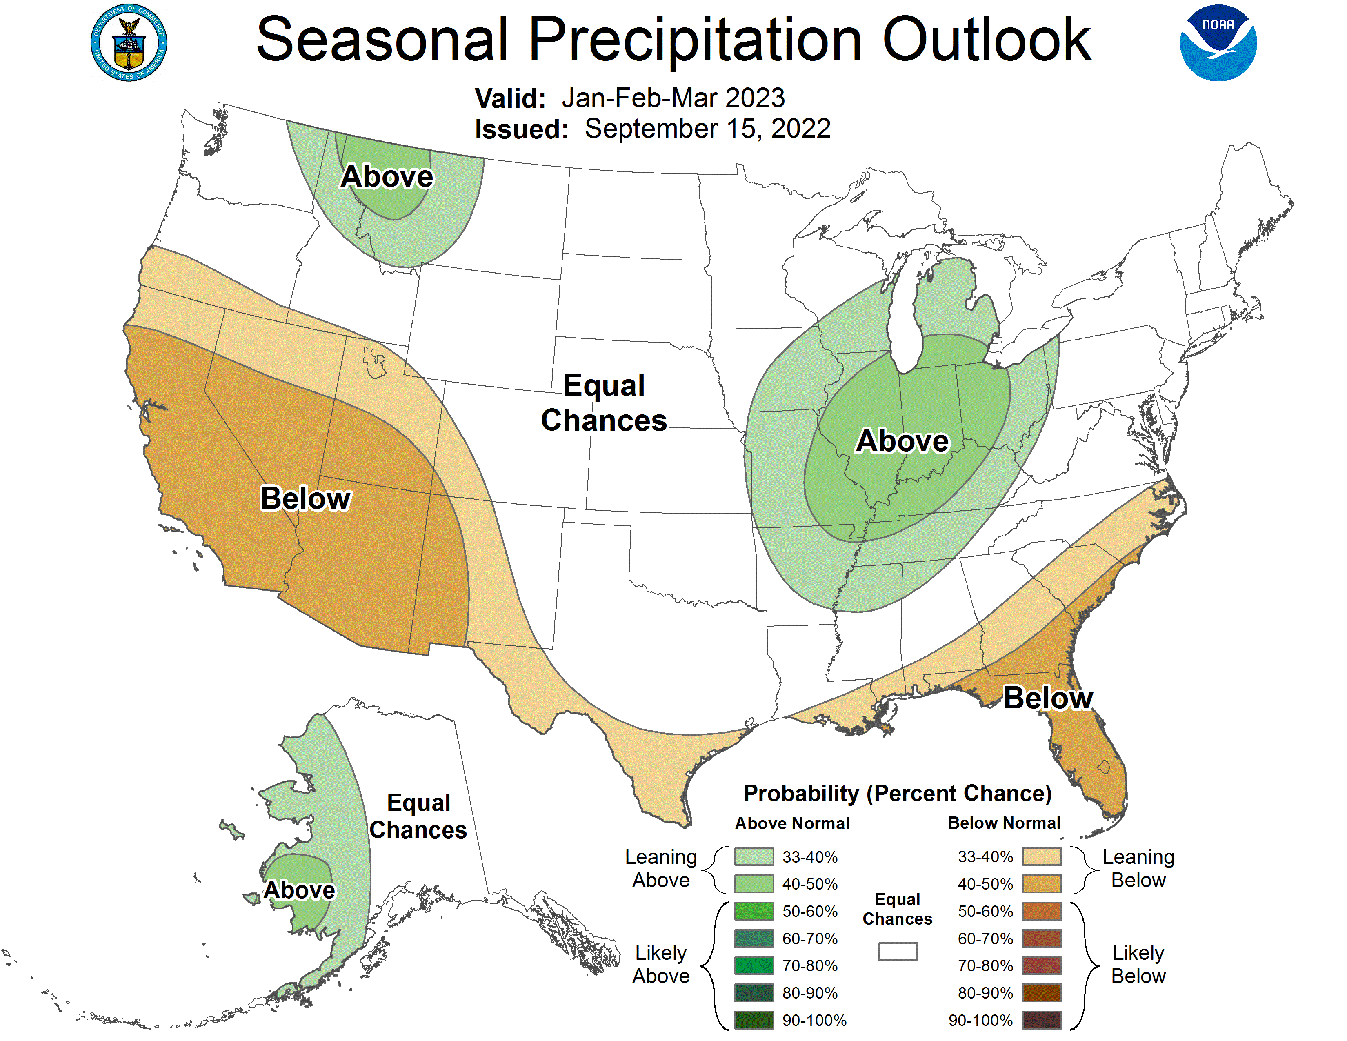

Slide 18
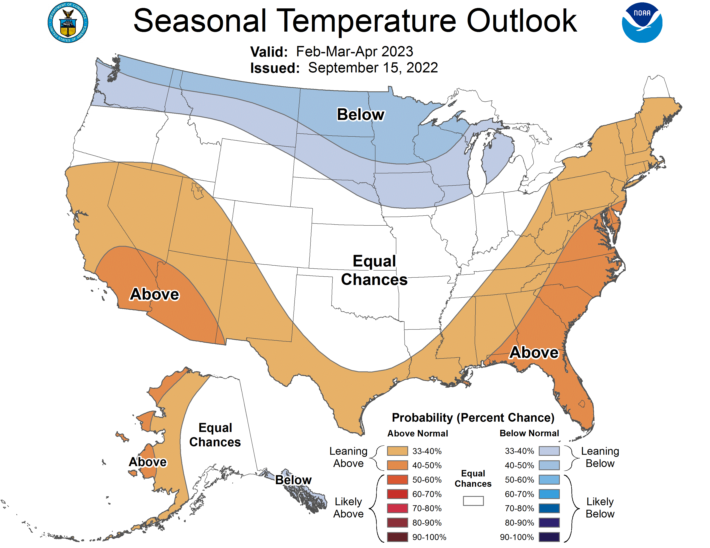

Slide 19
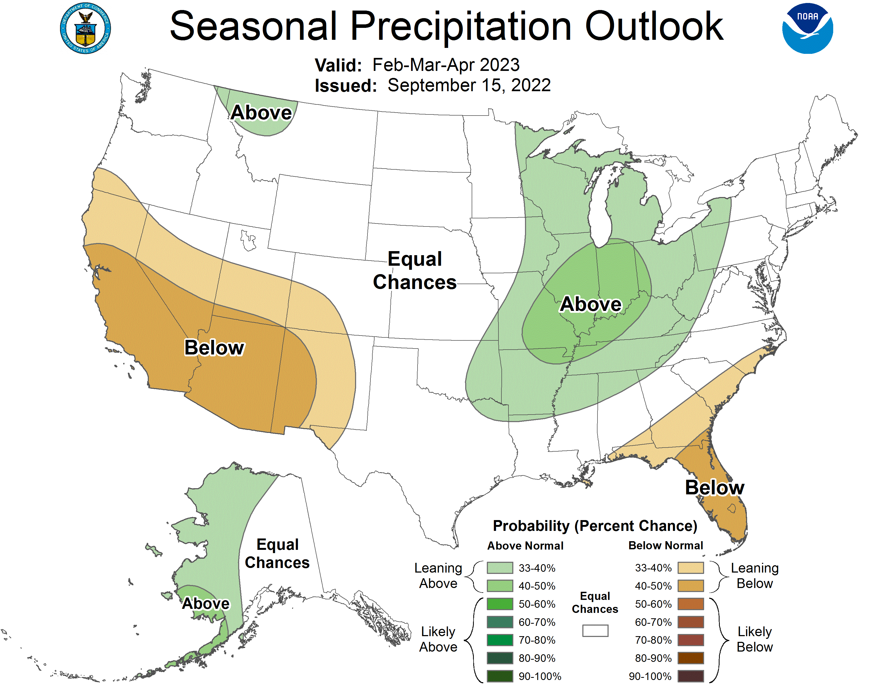

Slide 20
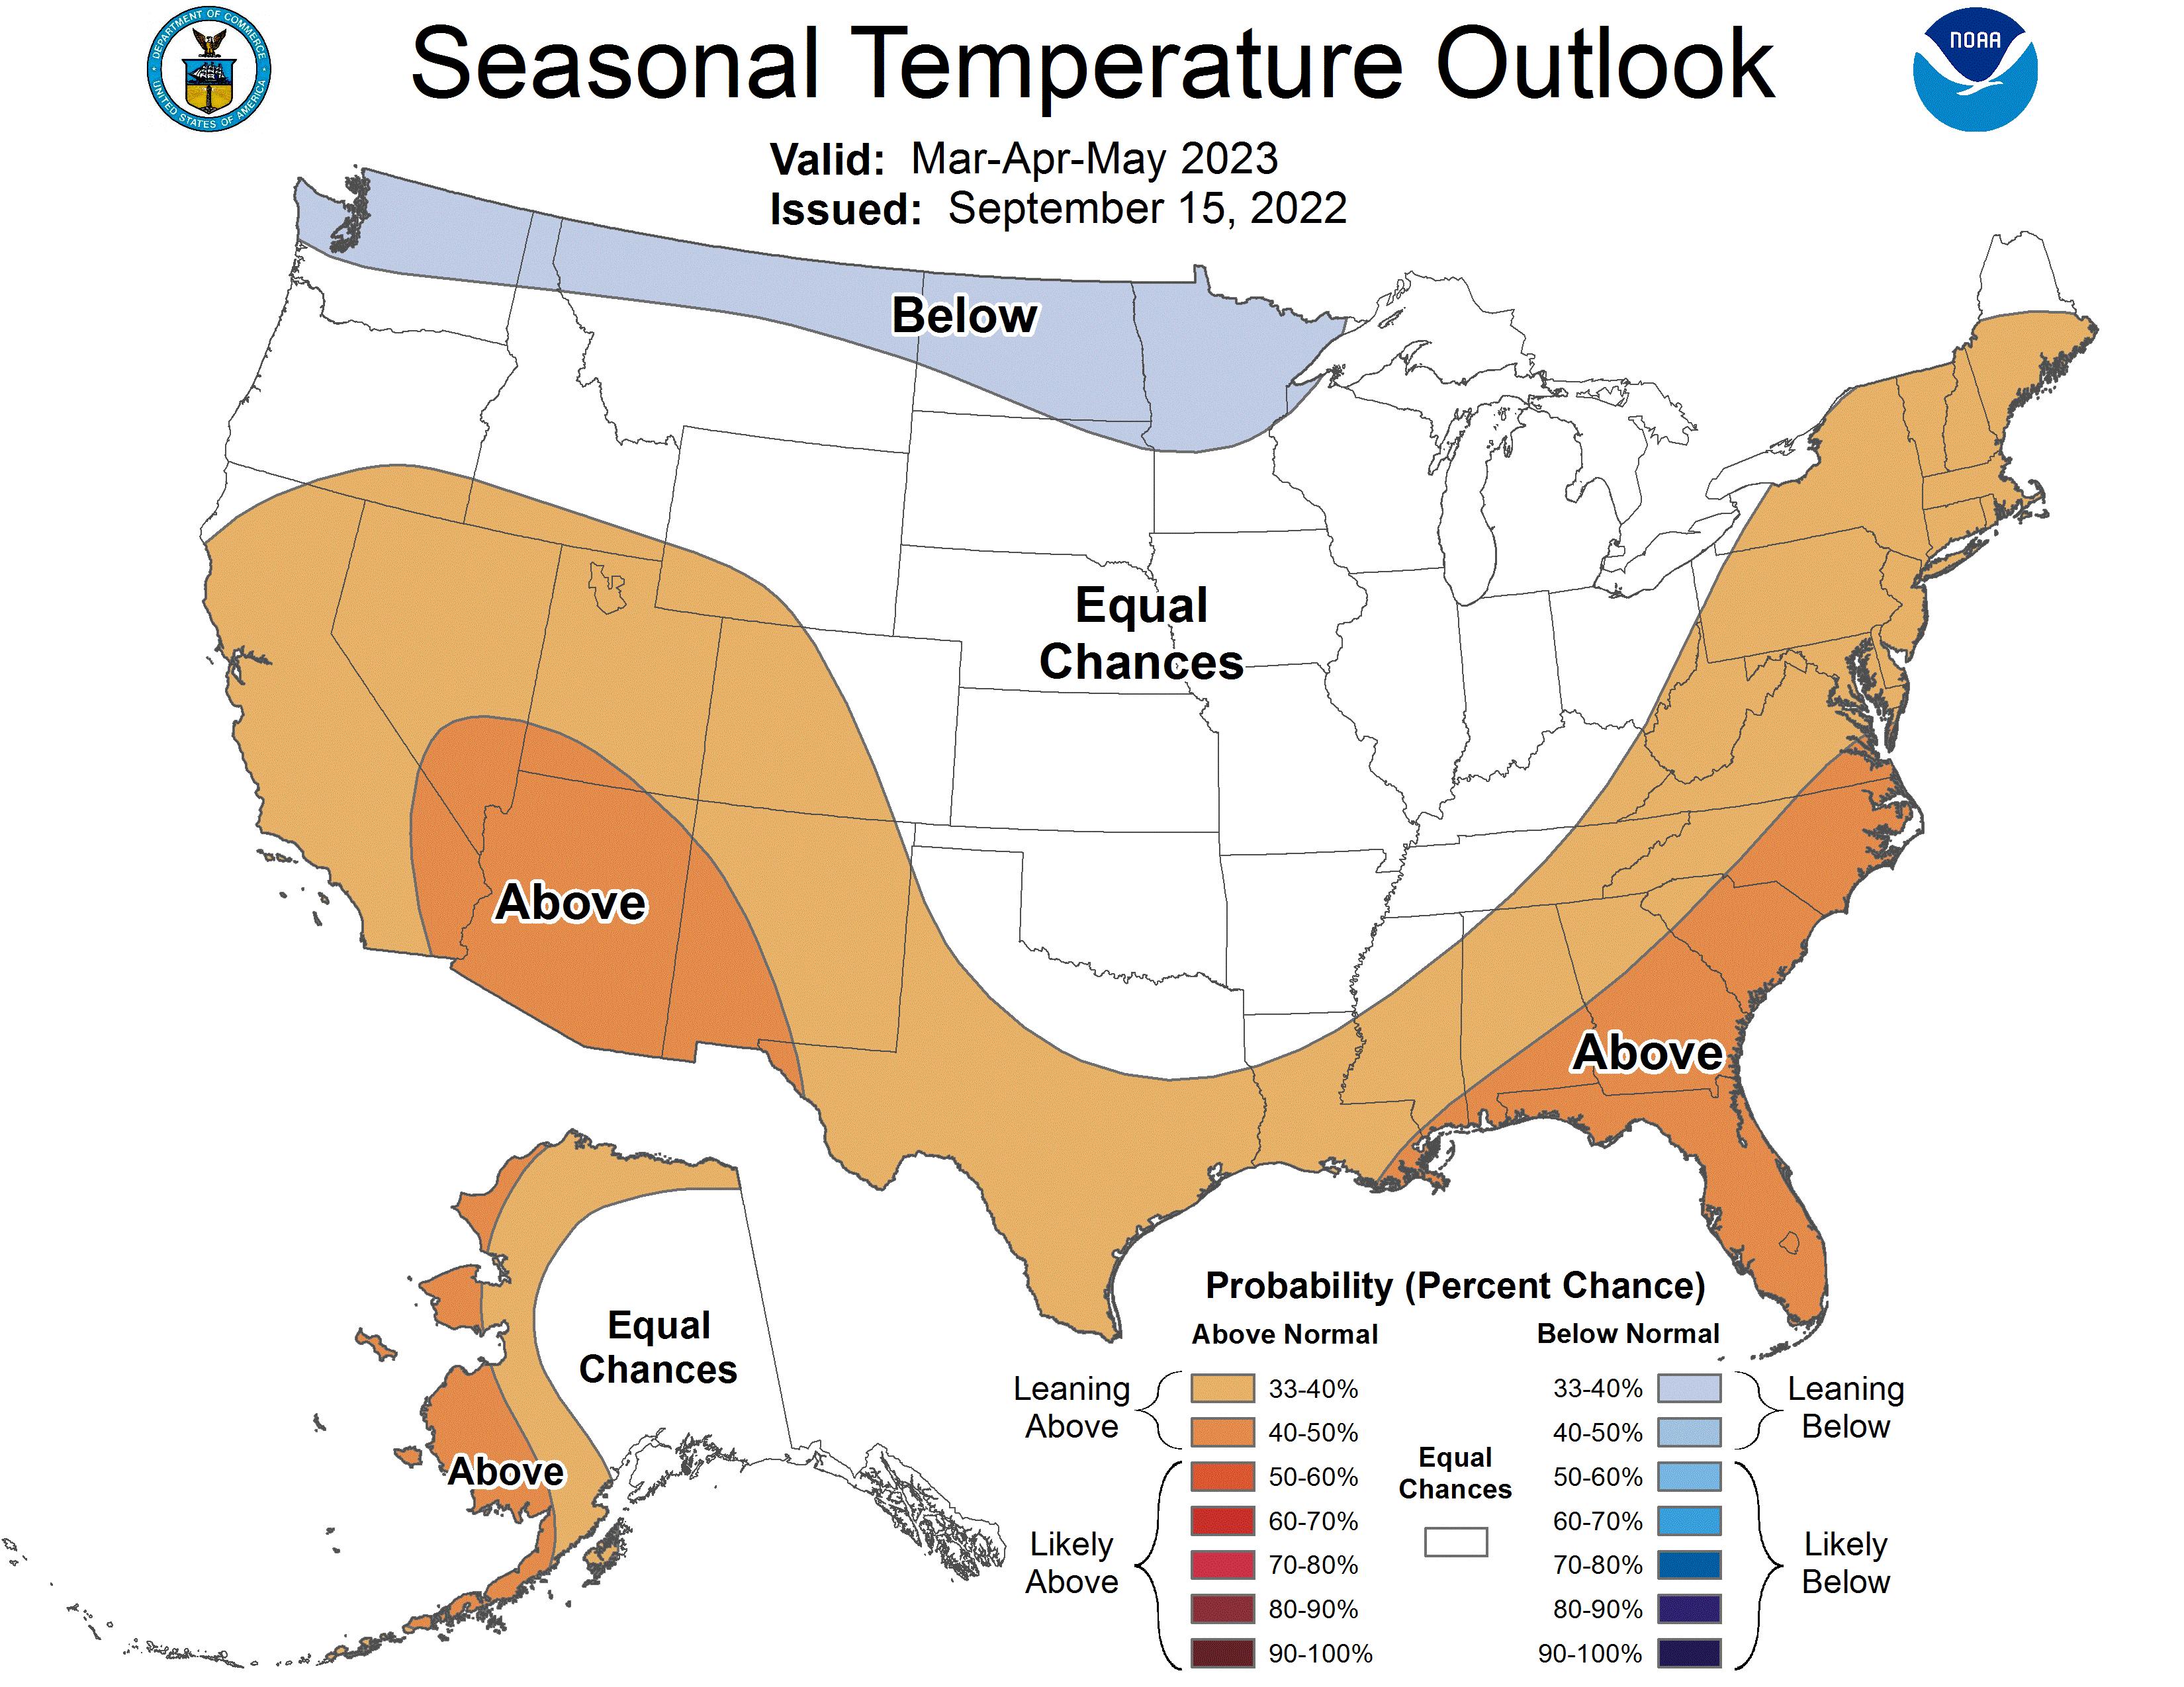

Slide 21
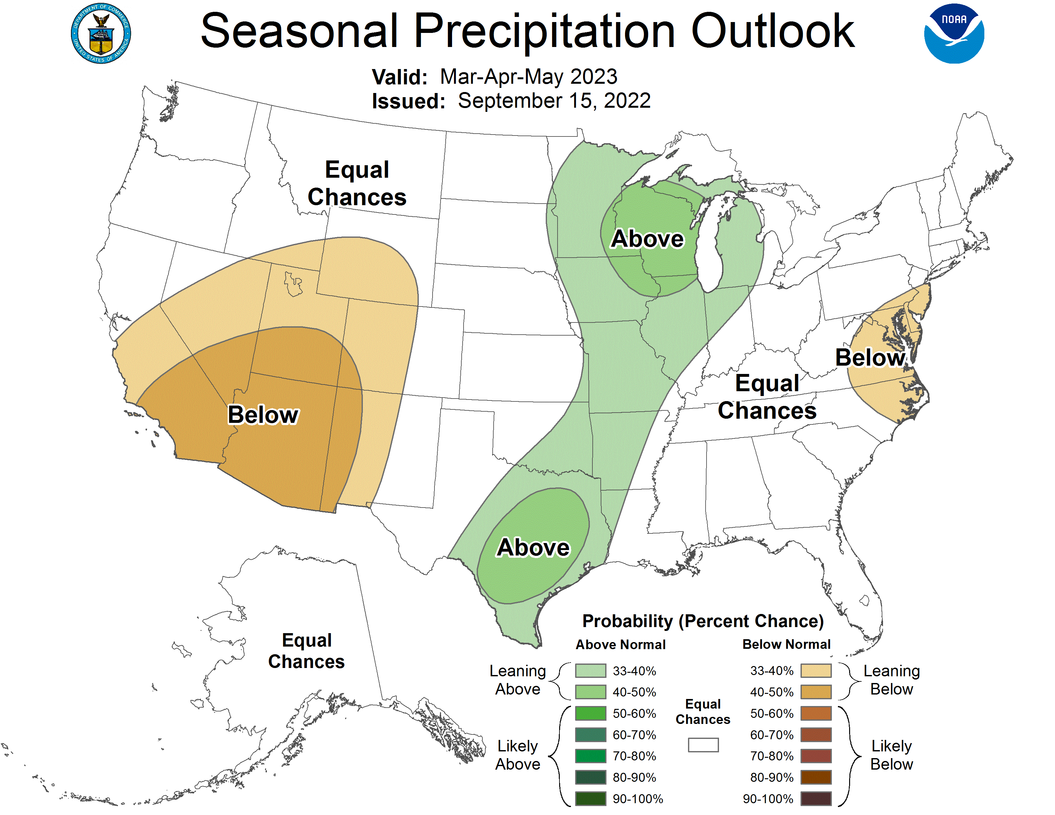

Slide 22
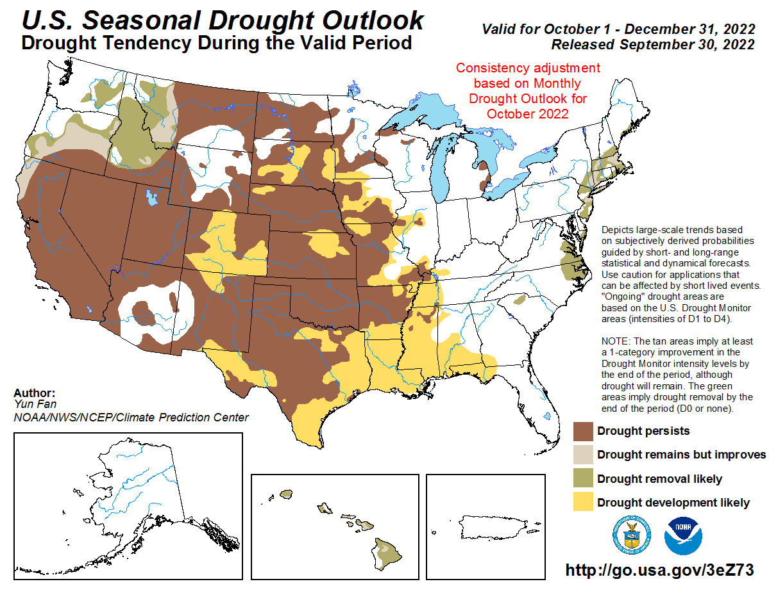

Slide 23
Sonoma County Drought Outlook
October 2022
Photo: USACE
Presented by: Brian Garcia - Warning Coordination Meteorologist NWS Bay Area

