Slide 1
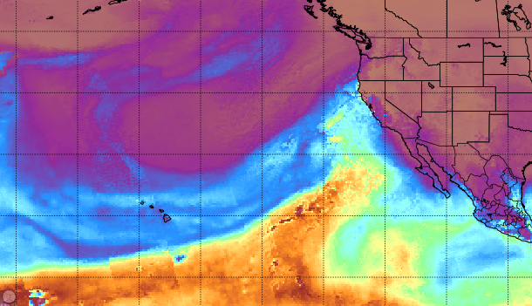

Atmospheric Rivers
Julie Kalansky
Sonoma Town Hall
November 10, 2022

Slide 2
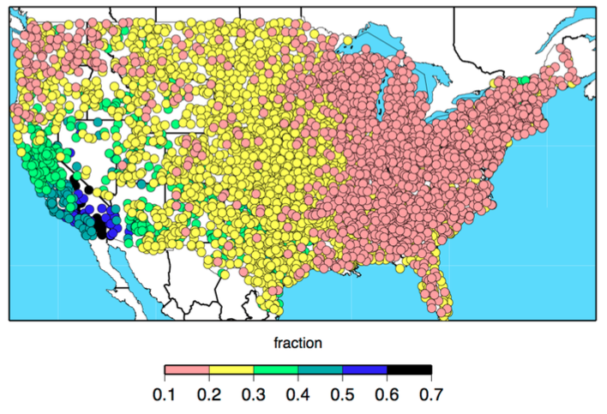
California Has Greatest Variability of Annual Precipitation in the U.S.
Total precipitation varies only slightly from year to year
CA precipitation VARIES GREATLY from year to year
Coefficient of variation for annual
Precipitation, 1950-2008
Dettinger, M.D., Ralph, F.M., Das, T., Neiman, P.J., and Cayan, D., 2011: Atmospheric rivers, floods, and the water resources of California. Water, 3, 455-478.
Notes:
Variability in CA can exceed half the annual average
The year to year variability in CA is largely caused by the wettest days (ARs).

Slide 3
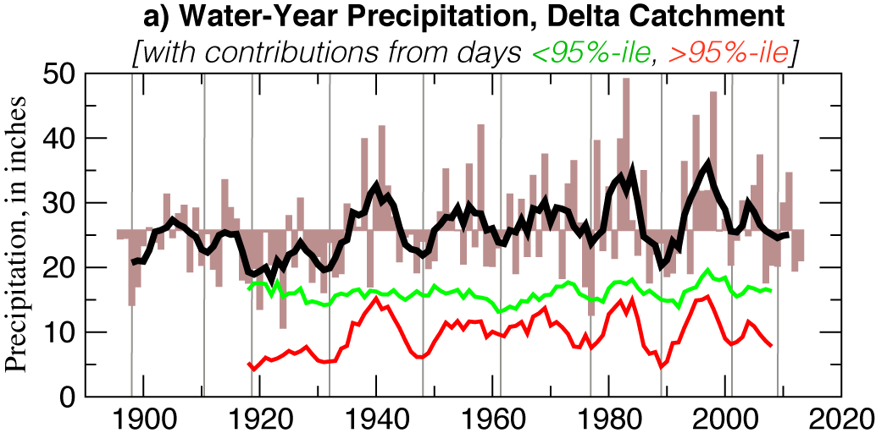
A few Large StormS (or their Absence) account for a disproportionate amount of CA’s precipitation variability
WHETHER A YEAR WILL BE WET OR DRY IN CALIFORNIA IS MOSTLY DETERMINED BY THE NUMBER AND STRENGTH OF ATMOSPHERIC RIVERS STRIKING THE STATE.
Total precipitation
All Other Days
LARGE STORM
CONTRIBUTION
Dettinger and Cayan, Drought and the Delta—A Matter of Extremes, San Francisco Estuary and Watershed Science, 2014.

Slide 4
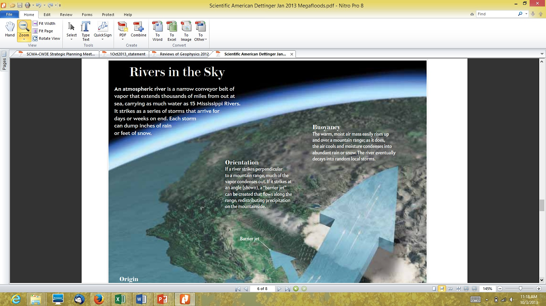
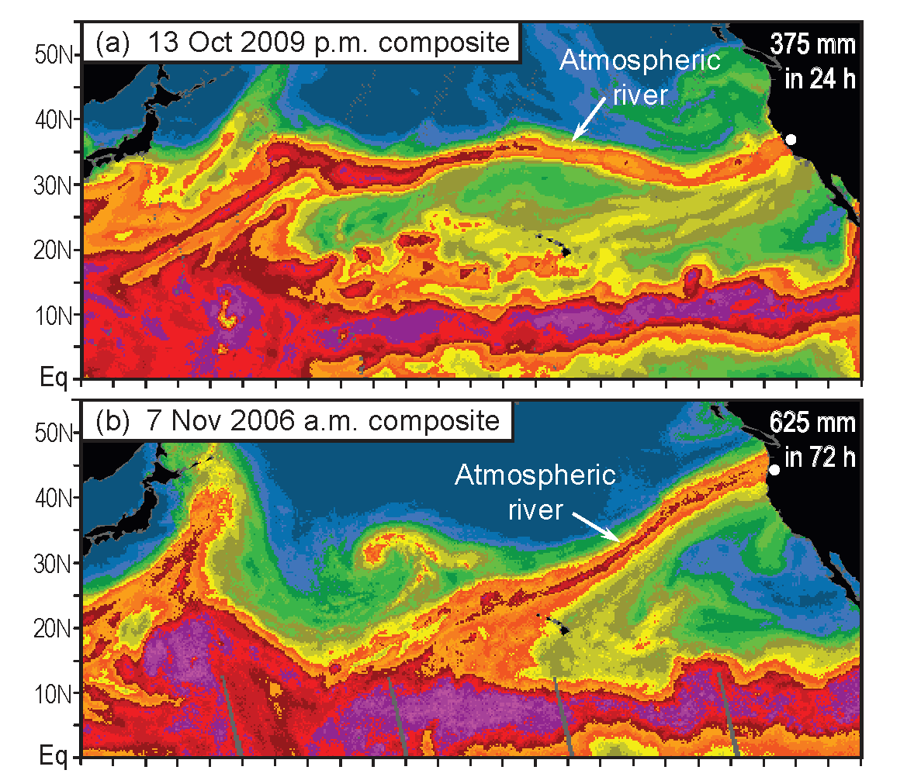
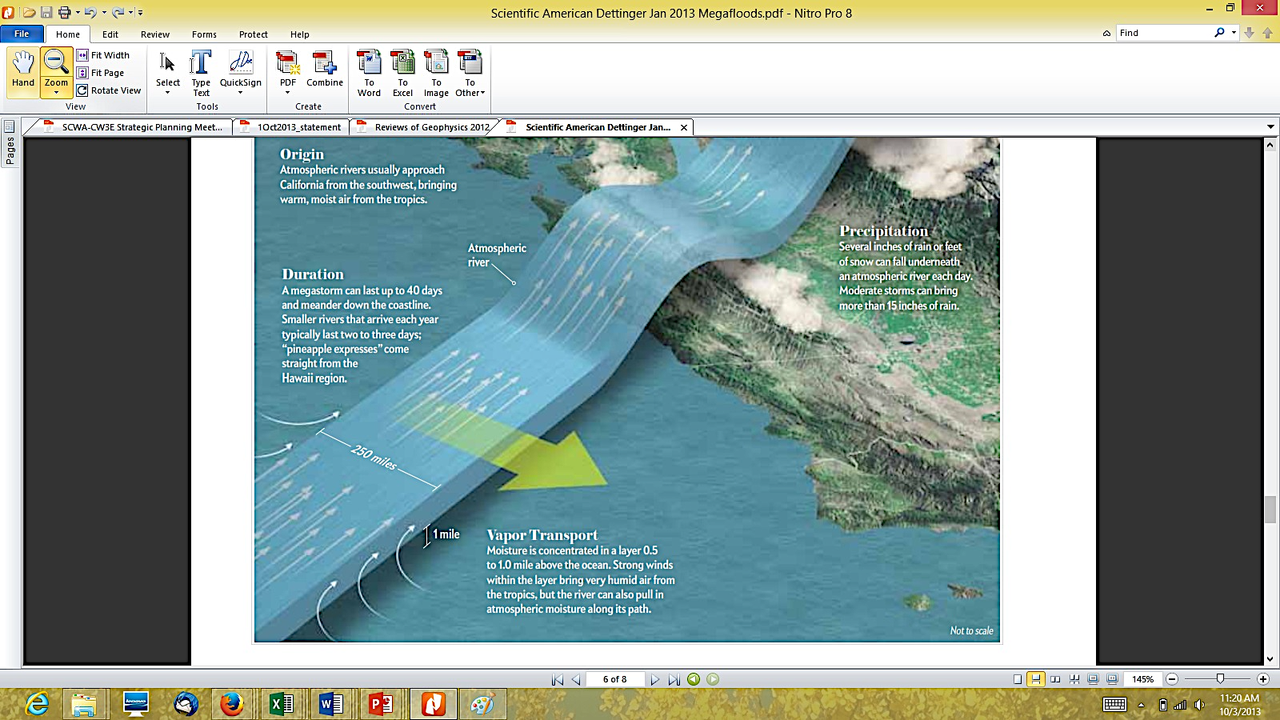
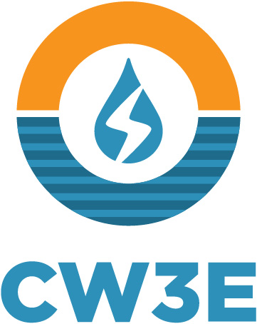

Key Science result: Atmospheric Rivers: Primary Source of Moisture for Precipitation in the region; useable predictive skill
Atmospheric Rivers (ARs) are Rivers in the Sky, i.e., long narrow bands of airborne water vapor, carrying as much water as 25 Mississippi Rivers*.
An AR that hit Washington & Oregon produced 25 inches of rain in 3 days.
ARs Can produce extreme precipitation and flooding.
However, ARs also provide up to half of annual precipitation and mountain snow that are key to water supply.
Dettinger and Ingram (2013, Sci. Amer.)
*Ralph et al. (2017)

Slide 5
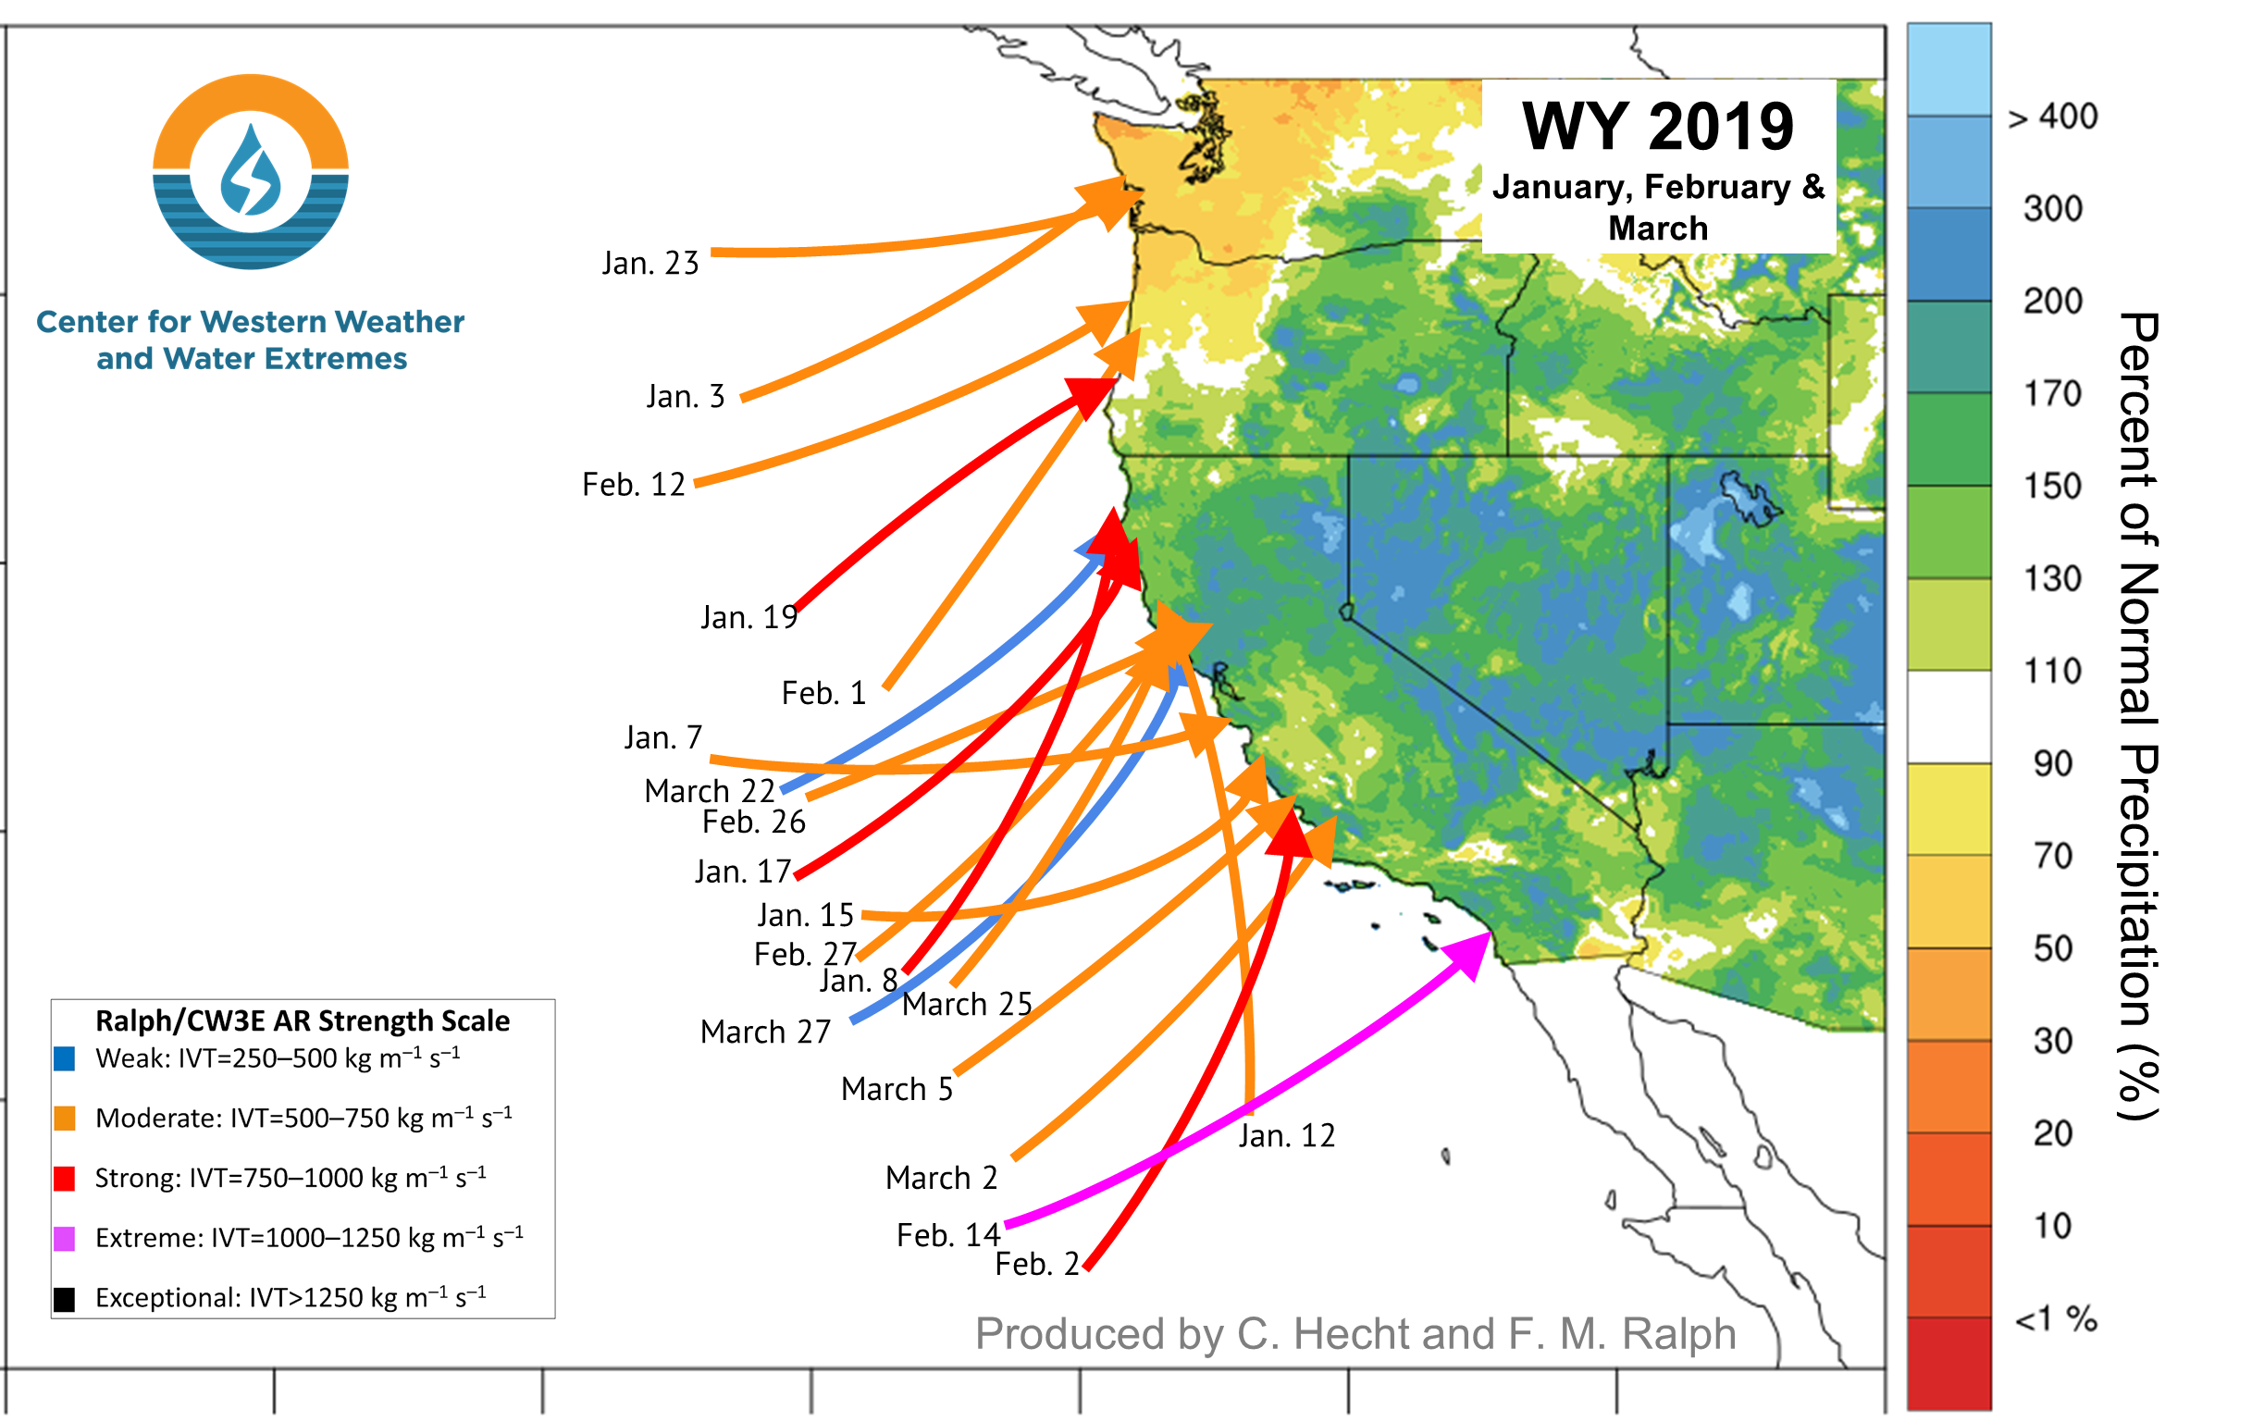
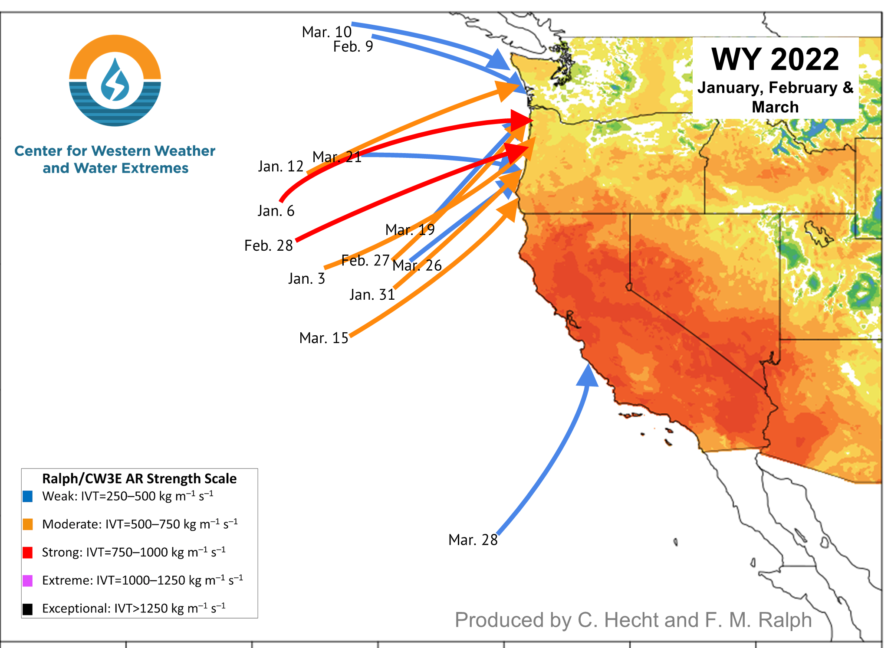
VARIABLITY & AR Landfalls

Slide 6
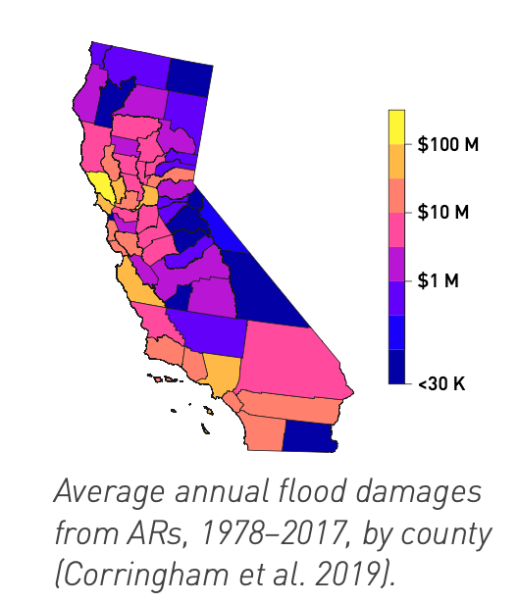
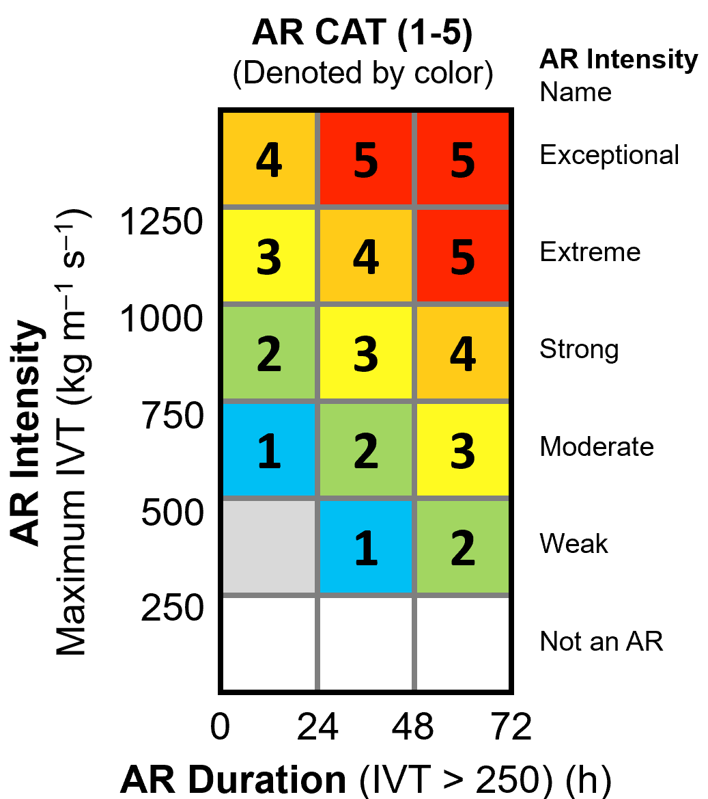
ARs drive flood damages in Sonoma & Western U.S.
Ralph et al. 2019 BAMS
AR Rank (1-5)
AR Rank
Mostly beneficial
Mostly hazardous
84% of All Flood Damages
over 40 years in the West
are from ARs
Corringham et al.2019, Science Advances
Flood damages increase
exponentially with AR Ranking
Corringham, Ralph, Gershunov, Cayan and Talbot, Sci. Advances (2019)

Slide 7
AR Flood Damages to Increase with Climate Change
Corringham et al 2022
$4b
Historical
High Emissions (RCP8.5)
Intermediate Emissions (RCP4.5)
$3b
Triple
By 2100
Annual Expected Damages
$2b
Double
By 2050
$1b
Past
Pre-1990
1990s
2020s
2050s
2090s
AR flood damages under the most likely emission scenario are projected to double by 2050s and triple by 2090s relative to 1990s

Slide 8
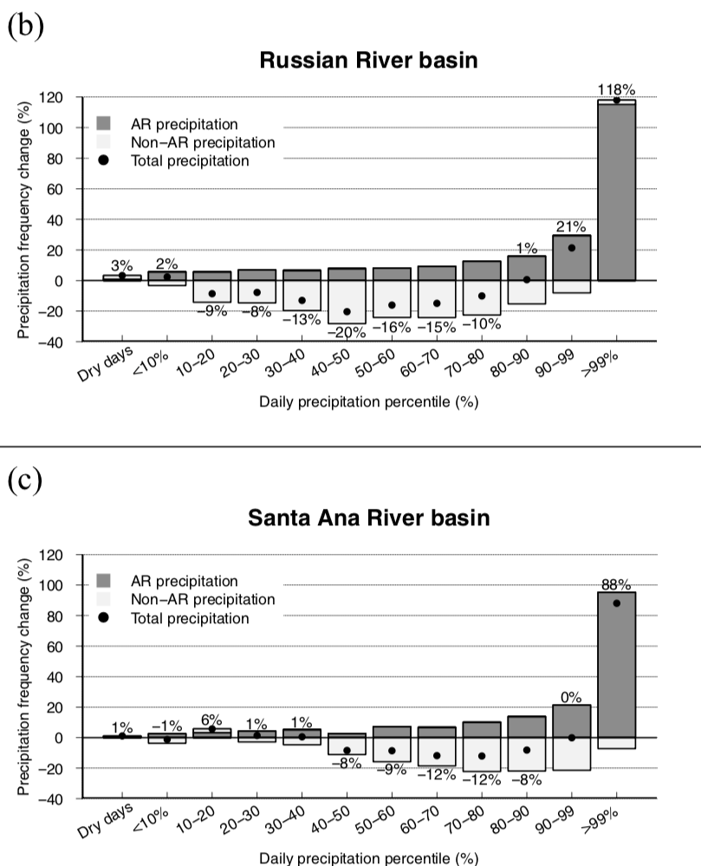
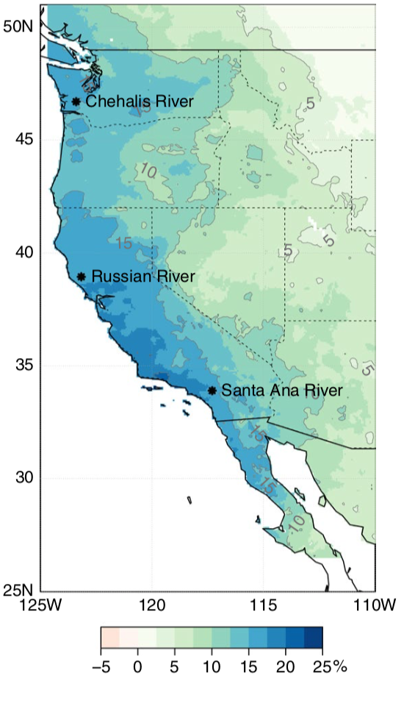
Future ARs
% change in the contribution of
ARs to total precipitation
The most Extreme Events are going to occur more often and are caused by ARs
Precipitation Regime change in Western North America: The role of Atmospheric Rivers
A. Gershunov, et al. (Scientific Reports 2019)
Future period is 2051-2100 relative to 1950-2005.

Slide 9
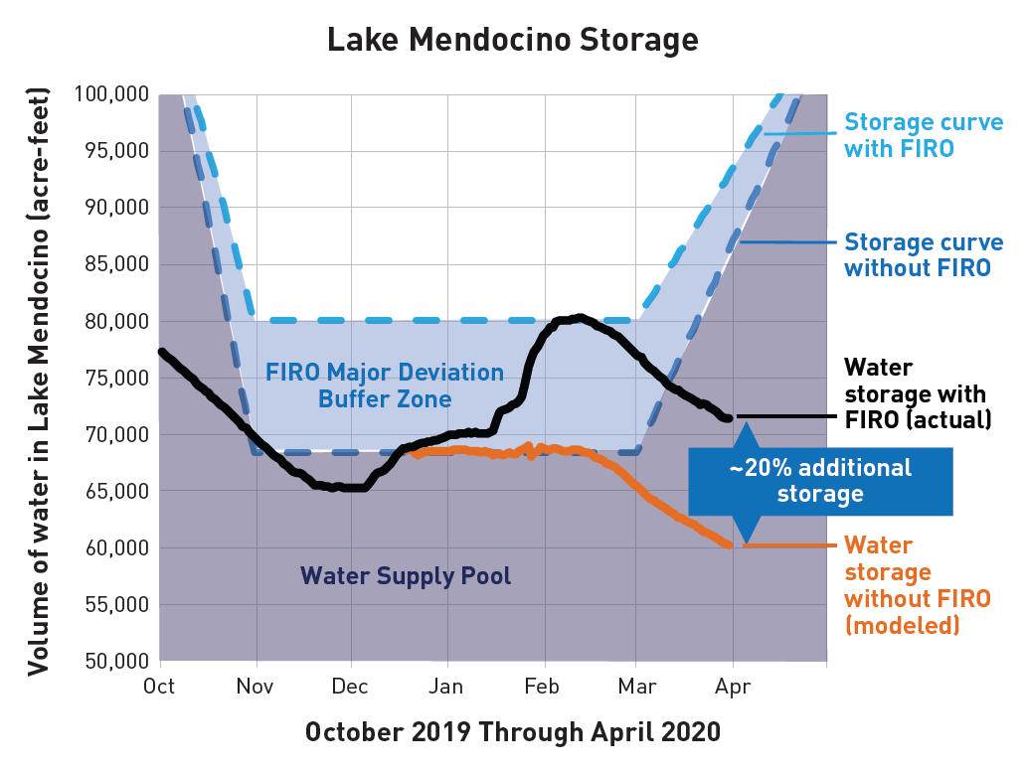
Forecast-Informed Reservoir Operations (FIRO)
FIRO brings reservoir operators together with engineers and scientists in a “Research And Operations Partnership”
FIRO explores using AR and related forecasts to
Hold extra water after a storm, pending a forecast of an AR
Release water ahead of an AR to increase flood risk mitigation capacity
Forecast Informed Reservoir Operations (FIRO) is a reservoir-operations strategy that better informs decisions to retain or release water by integrating additional flexibility in operation policies and rules with enhanced monitoring and improved weather and water forecasts (American Meteorological Society, 2020).
Water storage with FIRO
Water storage
Water storage without FIRO
F. Martin Ralph, Director, CW3E
mralph@ucsd.edu
https://cw3e.ucsd.edu/firo/

Slide 10
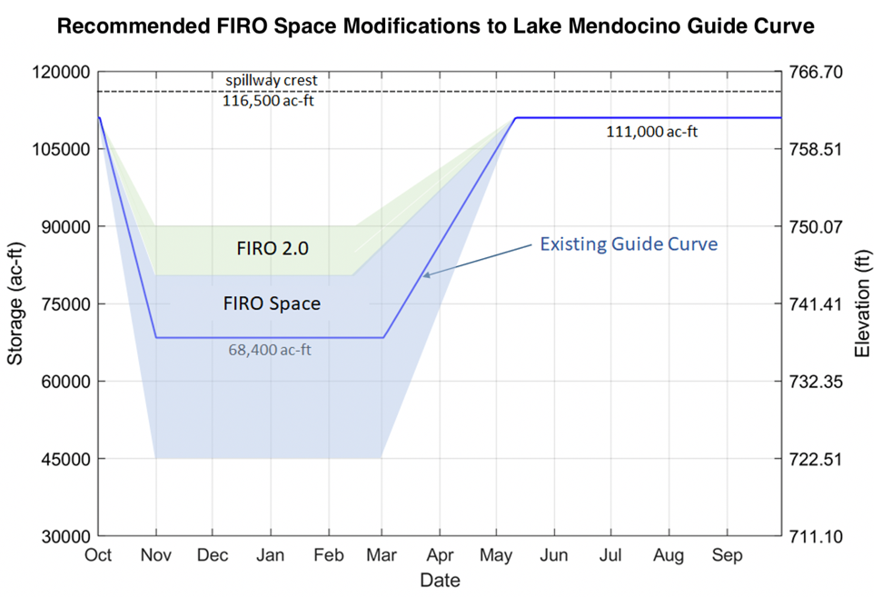
Concept of FIRO Space and “FIRO 2.0”
The better the AR forecast, the greater the climate adaptation potential for both drought and flood
https://cw3e.ucsd.edu/firo/

Slide 11
Conclusions
California has the highest year to year variability in precipitation in the US
Atmospheric rivers are important for water supply. If there are too few can lead to drought, but too extreme can lead to flooding
Atmospheric rivers cause almost all the flood damages in Sonoma County and damages increase by AR rank
Atmospheric rivers will become more important in the future – both for water supply and potential to cause flooding
Forecast Informed Reservoir Operations (FIRO) is used forecast to improve water availability
Improvements to the forecast enable more flexibility in water management and build more resilience to both floods and droughts
Questions?
jkalansky@ucsd.edu

